Slide 1
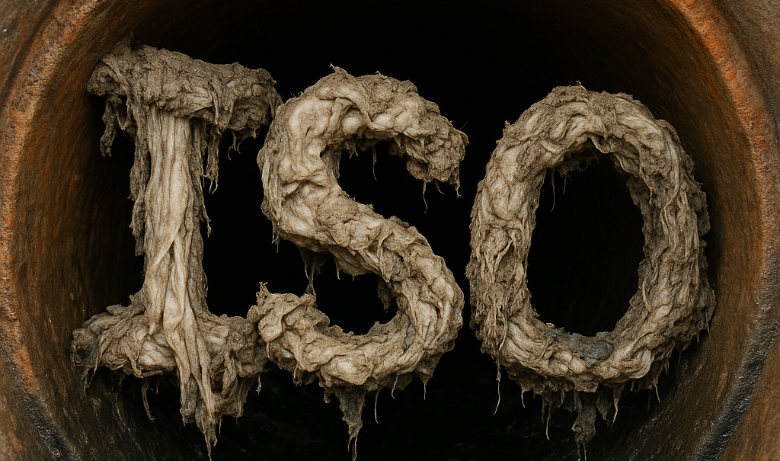
Wet Wipes and Wastewater Systems: ISO Standards and the UK–European Regulatory Direction: An overview of ISO TC 224 developments, testing methodologies, and regulatory trends affecting export markets .Still “Stuck in the pipes.” Wednesday 11th March,2026
DRAFT DNF SYMBOL (ISO)

Slide 2
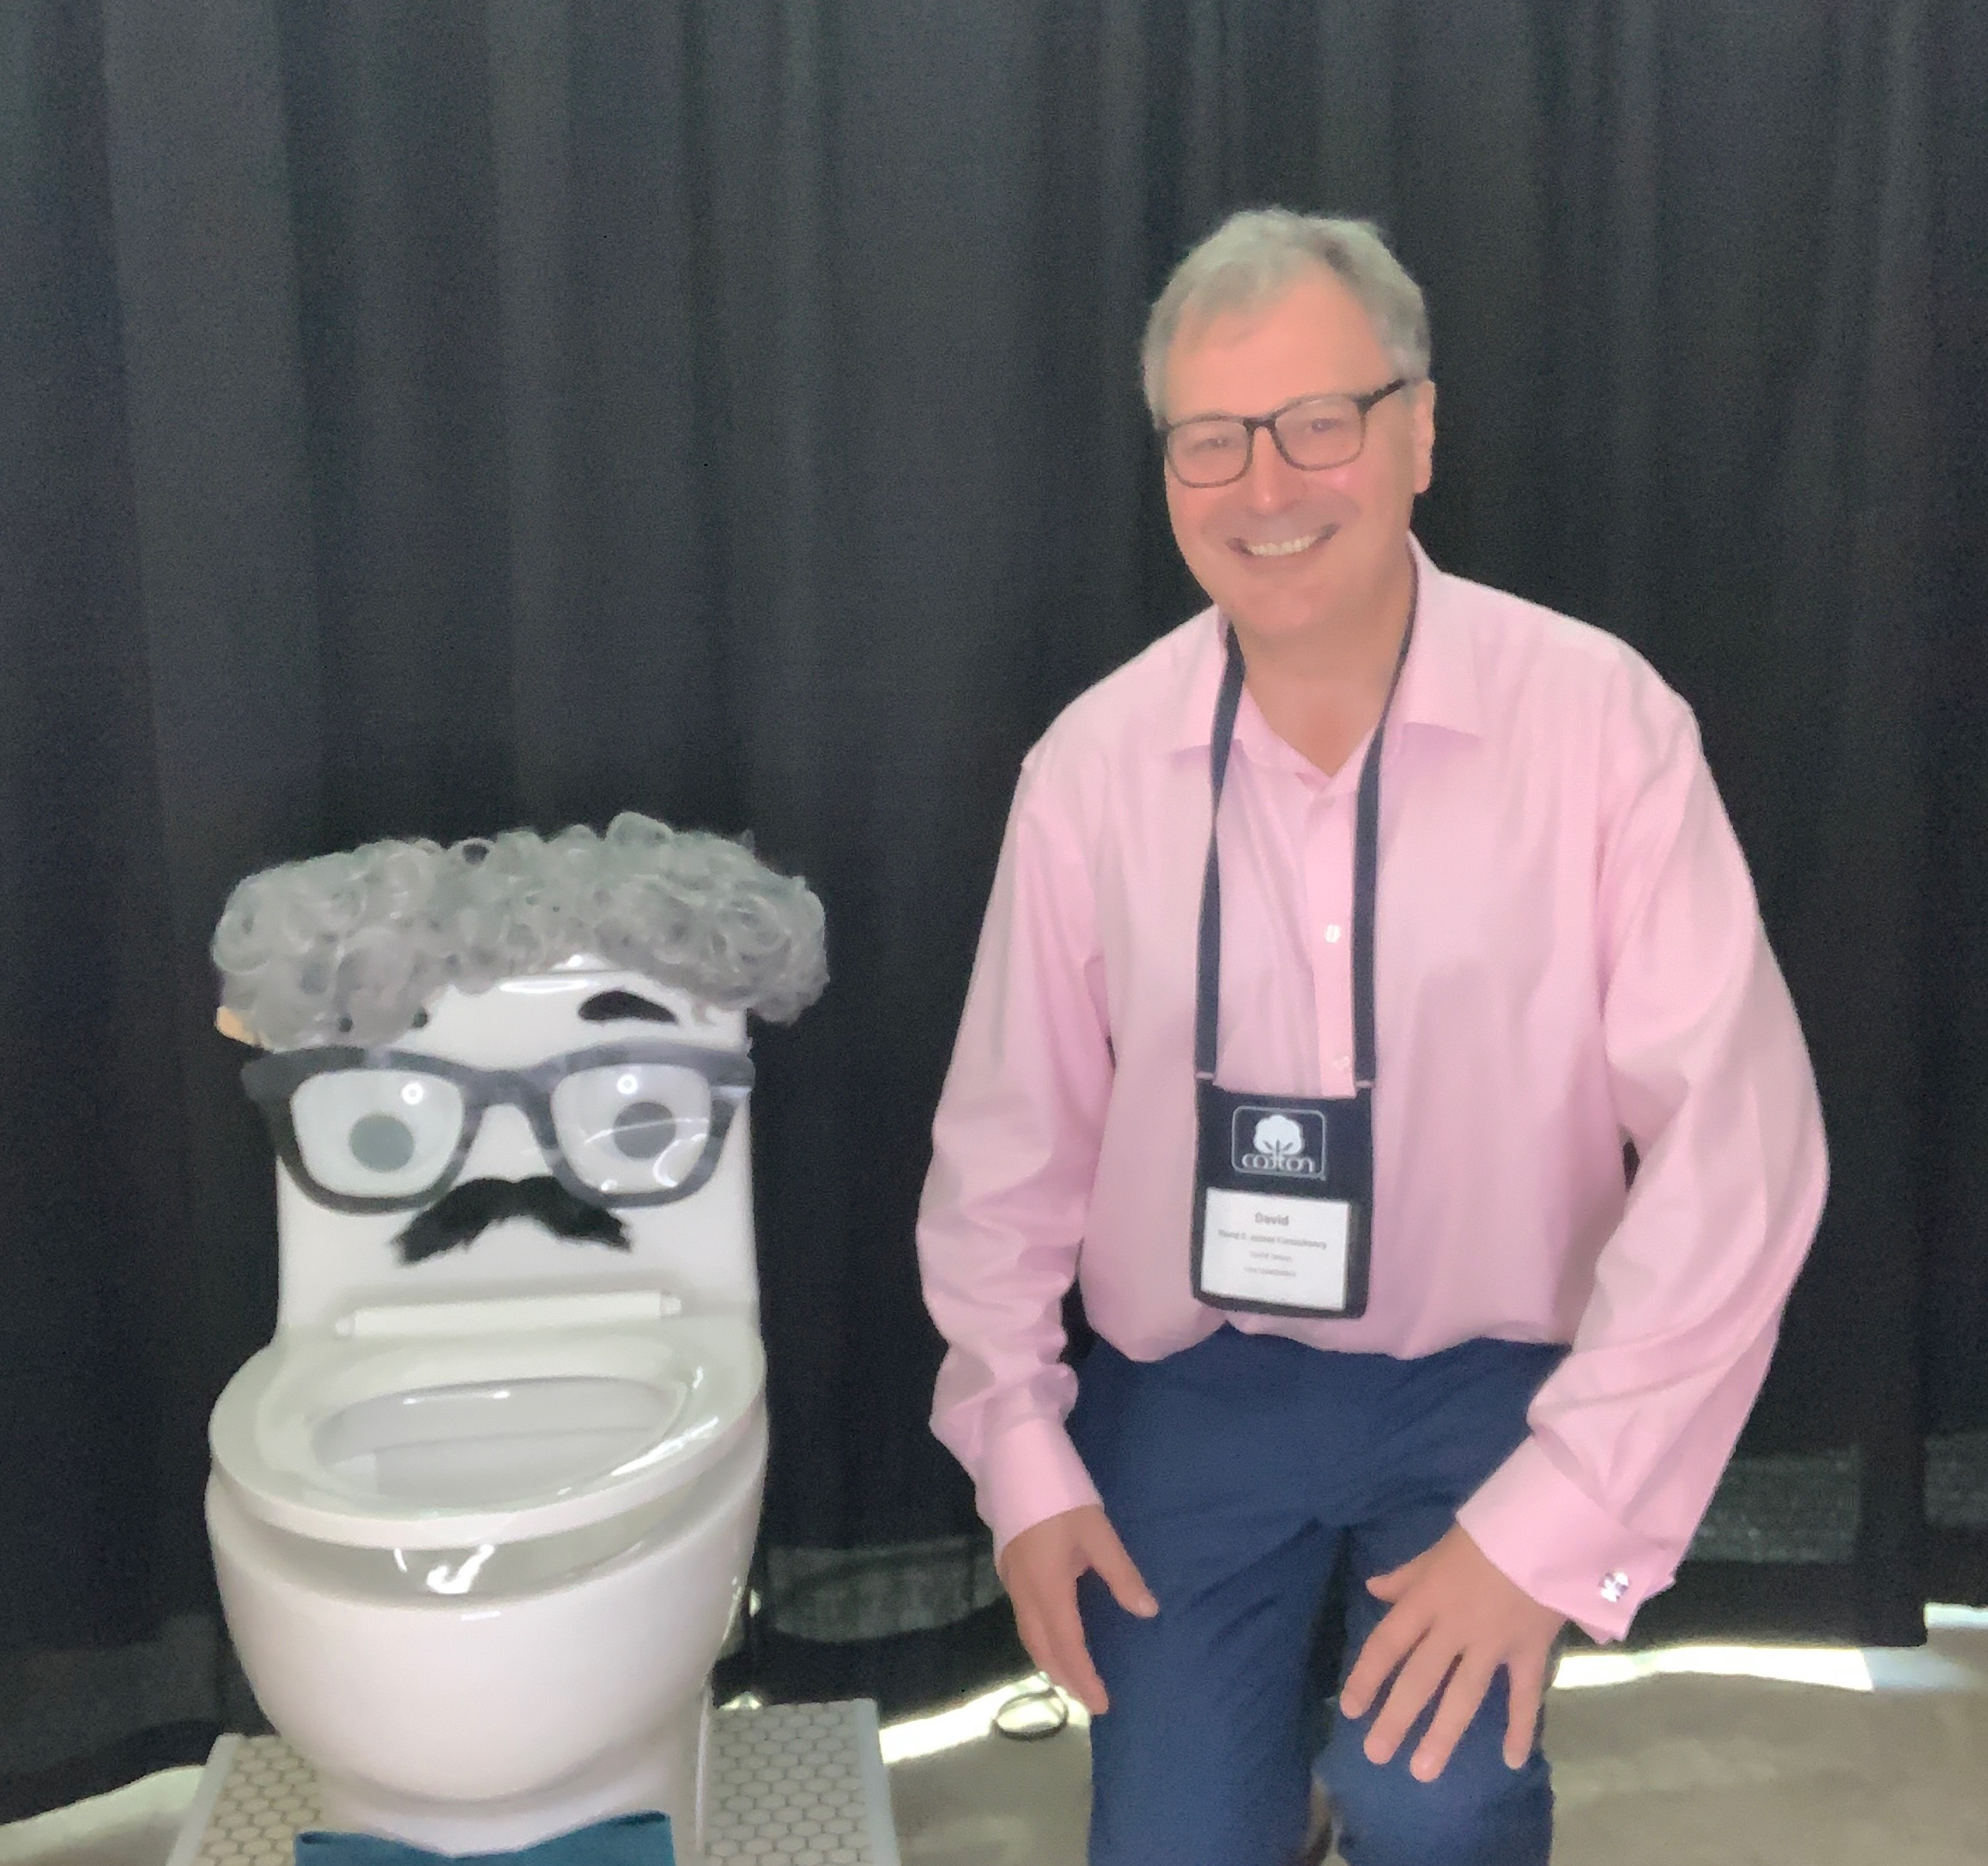

M: +447881940067 E: David@davidejamesconsulting.co.uk W: https://davidejamesconsulting.co.uk Enquiries@davidejamesconsulting.co.uk
The views expressed in this presentation are my own and do not reflect any organisation / body. I am not expressing any views on behalf of or reflective of the UK delegation to ISO TC224WG10.

Slide 3
Timeline of Key Events It is a part of my working lifetime in wipes !
1995 – In a study by Ashley et al. 2002 with the work undertaken in Scotland from 1995 some thirteen items prone to flushing were identified, wet wipes were not mentioned.
2003 – "Protocols to assess the breakdown of flushable consumer products"(peer reviewed) WERF.
2005 – Initiation of development of GD1
2008 June – Guidance document for assessing the flushability of nonwoven consumer products (GD1) EDANA/INDA
2009 June – Guidance document for assessing the flushability of nonwoven consumer products (GD2) INDA/EDANA
2011 August & October – Assessment of sewer and pump clog blockages UK
2012 January – "Benefits of unified communication. Unified communications between the water industry and the nonwovens industry is only possible if there is agreement on what is meant by flushable, while we are getting closer to an agreement we are not there yet."(Minutes EDANA/WATER UK Meeting, January)
2013 June – GD3 Published (NO PEER REVIEW) EDANA/INDA
2014 April- May – ISO TC 224 WG Starts work on first Iteration Technical Specification
2016 September – • to cease the project ISO/TS 24524 immediately
2016 November – WG10 to cease work ISO TC 224/WG 10 is suspended pending the outcome of a challenge to TC 224 from ISO TC 6/SC 2 and ISO TC 6/SC 2/WG 27 that TC 224 WG 10’s activities are outside the scope of TC224
Much larger excel spreadsheet of key events available.

Slide 4
Timeline of Key events contd.
2017 April – The results of the CIB (ISO TC 224 N911) dated 2017-02-27 proposing the change of product for WG 10 from a Technical Specification to a Technical Report
2017 March-October – Wipes in Sewer Audit UK(co-funded 12 Water&Sewerage companies in the UK, EDANA members, EDANA and DEFRA)- Looked at Waste water treatment plant, Small sewer pipe clogs and pump clogs
2017 December – Results of Wipes in Sewer Audit (UK) gain media attention "Wet wipes make up 93 % of matter causing UK Sewer blockages"
2018 – GD4 Published
2019 February – PD ISO/TR24524:2019 Published
2019 June – Directive 2019/904 - The Single use Plastics Directive
2021 June – Commission guidelines on single-use plastic products in accordance with Directive (EU) 2019/904
2022 March – Code of Practice Communicating disposal pathways for single use nonwoven wet wipes to protect wastewater systems (Third Edition)
2022 July – NWIP Reactivation of WG10 with Dr. Greg Ryan as Convenor. "Method for determining products suitable to be flushed down a domestic toilet and establishment of appropriate labelling requirements"
2022 July – California AB 818 Solid waste:Premoistened nonwoven disposable wipes- Came into Force
2023 October – California Collection study
2024 October – NO VOTE AGAINST DIS
2025 June – Publication of The Environmental Protection (Single Use Plastic Products) (Wet Wipes) Wales Regulations 2025
2025 July – Independent Water Commission report published in the UK. “The Cunliffe review”
2025 Sept – USA WIPPES ACT:- A Senate version of the bill, S. 1092, was introduced and referred to the Senate Commerce Committee. It was reported out of committee and placed on the Senate legislative calendar.
2025-November. Environmental Protection (Wet Wipes containing plastic) (England) Regulations.2025 (Into force Spring 2027)
2026-February. Environmental Protection(Wet wipes containing plastic)(Scotland)Regulations 2026(Into force 11August,2027).

Slide 5
International Standard(IS)/ Technical Specification(TS)/Technical report (TR) “DELIVERABLES”
International Standards An International Standard provides rules, guidelines or characteristics for activities or for their results, aimed at achieving the optimum degree of order in a given context. It can take many forms. Apart from product standards, other examples include: test methods, codes of practice, guideline standards and management systems standards.
Technical Specification A Technical Specification addresses work still under technical development, or where it is believed that there will be a future, but not immediate, possibility of agreement on an International Standard. A Technical Specification is published for immediate use, but it also provides a means to obtain feedback. The aim is that it will eventually be transformed and republished as an International Standard.
Technical Report A Technical Report contains information of a different kind from that of the previous two publications. It may include data obtained from a survey, for example, or from an informative report, or information of the perceived “state of the art”.
Source: https://www.iso.org/deliverables-all.html (Accessed March ,2026)

Slide 6
ISO Committee Membership & Liaisons
Category | Who they are | Rights & Role | Voting Rights
P-members (Participating) | NSBs that commit to active participation | Attend meetings, submit comments, nominate experts, must vote on drafts | ✅ Yes
O-members (Observing) | NSBs that only wish to follow the work | Receive documents, may comment, may attend as observers | ❌ No
A-liaisons | External orgs with broad relevance (e.g., IEC, ITU, trade bodies) | Contribute input, attend meetings, receive documents | ❌ No
D-liaisons | External orgs directly linked (e.g., industry associations, NGOs) e.g. INDA/ EDANA | Nominate experts, participate in discussions, provide technical input. Cannot be project leaders or convenors. | ❌ No
A working group comprises a restricted number of experts individually appointed by the P-members, A-liaisons of the parent committee and D-liaison organisations, brought together to deal with the specific task allocated to the working group. The experts act in a personal capacity and not as the official representative of the P-member or A-liaison organization (see 1.17) by which they have been appointed with the exception of those appointed by D-liaison organizations (see 1.17).
Categories of Stakeholder: A= Industry & commerce, B= Government, C= Consumers, E= Academics & Research Bodies, F= Standards Application, G= Non-Governmental Association.

Slide 7

Consensus.
“consensus: General agreement, characterized by the absence of sustained opposition to substantial issues by any important part of the concerned interests and by a process that involves seeking to take into account the views of all parties concerned and to reconcile any conflicting arguments. NOTE
Consensus need not imply unanimity.”
Source: Document: ISO/IEC Directives, Part 1 — Consolidated ISO Supplement (with IEC Supplement), Edition 2024 (Clause 2.5.6)

Slide 8
The first attempt to achieve a Technical specification on Flushable products April 2014-April 2017
NWIP (TC 224/N666) proposing the development of a TS with a scope: “to establish requirements concerning the quality and characteristics and for the certification of the performance of products that are declared to be flushable. Excluded from this standard are specifications or performance of the products for their advertised or intended use.”
35 P members of ISOTC 224 the result of the CIB was 28 ballots cast, 15 in favour, 5 against and 8 abstentions. The rest (7) did not vote.

Slide 9
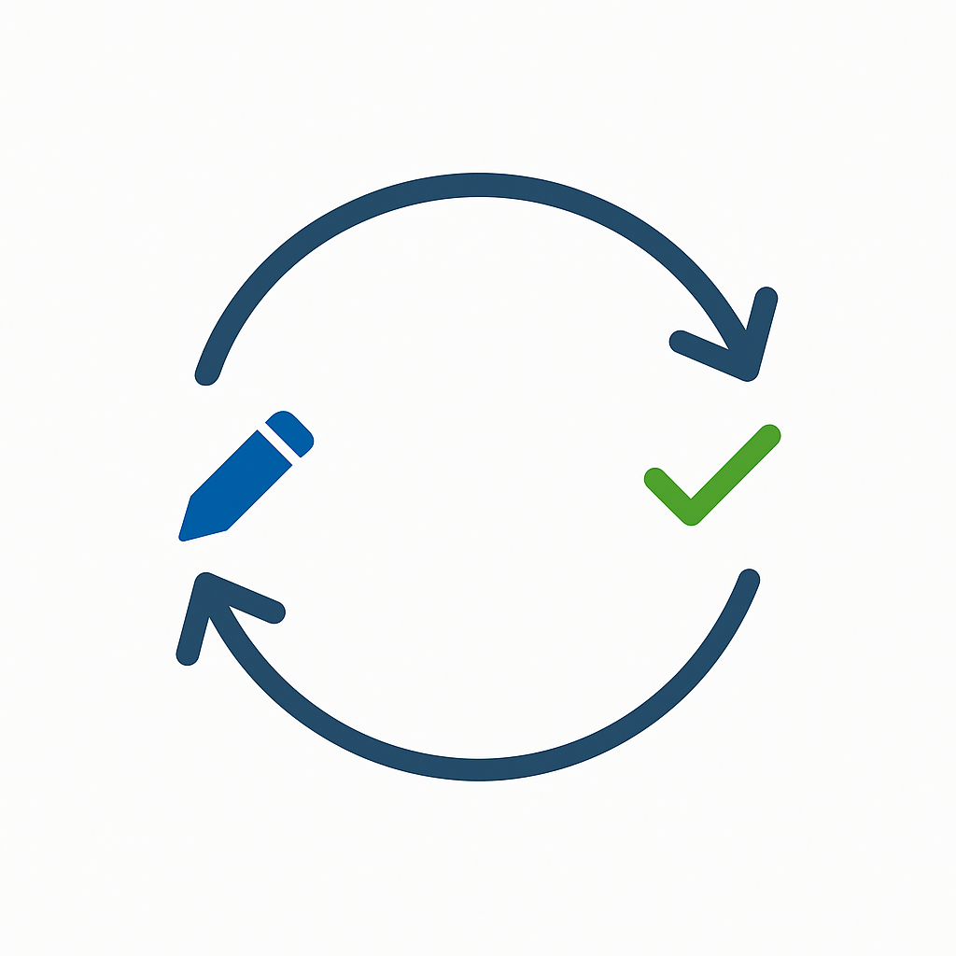
Typical ISO standard(deliverable) development process
Preliminary Work Item (PWI)
Two major groups of “experts”: “wastewater” services (both publicly and privately owned and regulated as to performance and rates and fees) and “manufacturers” (both publicly and privately owned)
New Work Item Proposal (NWIP)
Comments & voting
Working Draft (WD)
Comments & voting
Committee Draft (CD)
Comments & voting
Draft International Standard (DIS)
Comments & voting
Final Draft International Standard (FDIS)
Comments & voting
International Standard (IS)

Slide 10


First attempt to achieve a Technical Specification: April 2014-February 2019
Original NWIP
NWIP (TC 224/N666) proposing the development of a TS with a scope: “to establish requirements concerning the quality and characteristics and for the certification of the performance of products that are declared to be flushable. Excluded from this standard are specifications or performance of the products for their advertised or intended use”
-----------------------------------
The Scope of TC 224 excludes the development of a normative Standard
Concern expressed that TC 224 WG 10 was in conflict with ISO TC 6/SC 2/WG 27 by writing (a). analytical methods, and (b). establishing threshold values ,both of which are excluded from the scope of TC 224
-------------------------------
Revised NWIP:
NWIP (TC224/N911) to revise the work of WG10 to produce a Technical Report “on the Hydraulic, Mechanical and Environmental Conditions Found in Wastewater Transportation and Treatment Systems and their Context”. The result of the CIB was 34 votes cast, 26 in favour (2 with comments), 0 opposed and 8 abstentions

Slide 11
ISO/TR 24524:2019 – Key Points 5 years and 544 N documents later ! (February,2019)
Title: “Service activities relating to drinking water supply, wastewater and storm water systems-Hydraulic, mechanical and environmental conditions in waste water transport systems” ISBN 978-058051153 available fromISO/TR 24524:2019 - Service activities relating to drinking water supply, wastewater and stormwater systems — Hydraulic, mechanical and environmental conditions in wastewater transport systems
Purpose: Defines conditions in wastewater transport systems
Covers toilets → drain lines → sewers → pumps → treatment plants
Objective: Avoid blockages, protect infrastructure, minimise environmental harm
Toilets
Designs/flush volumes vary globally; materials must not impair function
Drain Lines
Solids may strand, settle, or snag; typical: 75–100 mm diameter, 1–2% slope
Wastewater Transport
Transit to pump/screen: 30 min–6 h; risks include clogs & fouling
Screening & Treatment
Screens: 2–25 mm apertures; solids must settle (≥1 mm/s) & not disrupt treatment
Environmental Considerations
Plastics & microplastics are major concerns; biodegradability varies
FYI: The time frame for a Technical report is normally 12-18 months(ish). No real maximum life for a TR.

Slide 12
(July,2022) Précis of ISO N2159.(New work item proposal): “Method for determining products suitable to be flushed down a domestic toilet and establishment of appropriate labelling requirements”.
To be developed within ISOTC224WG10.
Scope: Defines criteria for flushable products; excludes toilet paper; includes tests (drain-line, pump/screen, disintegration, settling, biodegradation, persistence) and ISO-based labelling.
Purpose & Justification: Improper flushing causes blockages, costs ($500–1,000 per household), pump failures, landfill waste, and environmental damage. >1,000 tonnes/year removed. Affects manufacturers, consumers, utilities, environment, and communities.
Approach: Based on the conceptual framework of ISO TR 24524; tests ensure compatibility with plumbing, sewerage infrastructure, and environment. Products passing may carry standard flushable label.
Source Documents: INDA/EDANA (2018), IWSFG PAS 1–3 (2020), WaterUK/WRc WIS-4-0206 (2019), AS/NZS 5328 (2022 draft),China National Standards, UNE Spanish National Standard.
Labelling: Based on INDA/EDANA Code of Practice (2017).
Value: Clarity for manufacturers, protection of infrastructure, cost reduction, environmental protection.
UN SDGs: Goal 3, Goal 6, Goal 11, Goal 12, Goal 14.
Time frame for:
An International standard(draft- publication) 24-36 months.
Technical specification- (ca) 24 months. (Likely to be a 3- year review cycle).

Slide 13
Delegations to ISO TC 224 WG 10 Active National standards body participation in the process Participation is the best strategy.
Liaisons: INDA , EDANA, TC6.
(195⁺ countries in the world WG10 only has 34 delegations)
Argentina — IRAM | France — AFNOR | Norway — SN | Sweden — SIS
Australia — SA | India — BIS | Portugal — IPQ | Switzerland — SNV
Austria — ASI | Indonesia — BSN | Russian Federation — GOST R | Tunisia — INNORPI
Bolivia, Plurinational State of — IBNORCA | Ireland — NSAI | Saudi Arabia — SASO | Uganda — UNBS
Canada — SCC | Israel — SII | Senegal — ASN | United Arab Emirates — MoIAT-STR
China — SAC | Japan — JISC | Singapore — SSC | United Kingdom — BSI
Czech Republic — UNMZ | Kenya — KEBS | Slovakia — UNMS SR | United States — ANSI
Denmark — DS | Korea, Republic of — KATS | South Africa — SABS | Egypt — EOS
Finland — SFS | Morocco — IMANOR | Spain — UNE | Germany — DIN
Active participant in ISO TC224WG10, Secretariat, Delegations with nonwoven representation, Consistent do not believe in flushables other than pee, poo and paper.

Slide 14

The “mirror group”- My experience.
BS 0:2021 (A standard for standards) is BSI’s rules for standardization in the UK.
Section 7 deals with Committee membership and consensus.
Section 7.2 sets expectations for committee members.
“It is generally expected that those sitting on a committee will:
be able to demonstrate technical expertise or relevant knowledge or experience in some areas of the committee’s work; and
represent a collective body (nominating organization) that has a legitimate interest in the work of the committee.”
Membership is at the sole discretion of BSI although they would usually consult on applicants that are seeking individual membership .A national committee is ideally constituted with trade organisations, professional bodies, academia, government etc.
So, wherever you are based in the world you will have a National Standards body e.g. BSI, ANSI, AFNOR,SAC,JISC,BIS etc . You need to apply to join the relevant National mirror group by reaching out to your national standards body and see if they are partaking in the relevant Technical committee and if they are nominating experts to a particular working group. I reached out to “committee services centre” at BSI and quote the Working group I wanted to join . This is down to you / your organisation and not your trade body.

Slide 15
A non normative standard
The Scope of TC 224 excludes the development of a normative Standard that sets out normative targets or thresholds values for “Water service quality criteria”. Meaning the proposed Standard will instead include methodologies(without a pass/fail criteria) that can be used, will identify and harmonise equivalent tests, and provide pass/fail criteria as examples or recommendations

Slide 16





Delegations to ISO TC 224 WG 10 Active participation is the best strategy!
Liaisons: INDA , EDANA, TC6.
EUR EAU is not a Liaison.
Argentina — IRAM | France — AFNOR | Norway — SN | Sweden — SIS
Australia — SA | India — BIS | Portugal — IPQ | Switzerland — SNV
Austria — ASI | Indonesia — BSN | Russian Federation — GOST R | Tunisia — INNORPI
Bolivia, Plurinational State of — IBNORCA | Ireland — NSAI | Saudi Arabia — SASO | Uganda — UNBS
Canada — SCC | Israel — SII | Senegal — ASN | United Arab Emirates — MoIAT-STR
China — SAC | Japan — JISC | Singapore — SSC | United Kingdom — BSI
Czech Republic — UNMZ | Kenya — KEBS | Slovakia — UNMS SR | United States — ANSI
Denmark — DS | Korea, Republic of — KATS | South Africa — SABS | Egypt — EOS
Finland — SFS | Morocco — IMANOR | Spain — UNE | Germany — DIN
Active participant in ISO TC224WG10, Secretariat, Delegations with nonwoven representation, Consistent do not believe in flushables other than pee, poo and paper. Active “countries” that have national waste water operators that are EurEau members.

Slide 17

– The Voice of Europe’s Water Sector
Represents Europe’s drinking water and wastewater service providers
Umbrella association: 38 national associations across 32 countries. National associations of water and wastewater operators (not individual companies).
Covers utilities serving ~500 million people
Mission: Advocate for sustainable water services, influence EU policy, share collective expertise- utilities, municipalities, water boards
https://www.eureau.org
https://www.eureau.org/documents/diverse/8073-eureau-letter-to-iso-tc224-on-dis18671/file

Slide 18
























APDA (Portugal)
ARA (Austria)
AVS
BDEW (Germany)
CCMA
Italy
Cyprus
DANVA (Denmark)
EVEL (Greece)
IGWP (Poland)
Irwater
MaViz (Hungary)
Norsk Vann (Norway)
OWAV (Austria)
OVGW (Austria)
Serbia
SOVAK (Slovakia)
USSORB
UvW (Netherlands)
WSC (Malta)
Sweden
Water UK
Vewin (Netherlands)
VSA (Switzerland)

Slide 19












Belgaqua (Belgium)
Croatia
DVGW (Germany)
FIWA (Finland)
FP2E (France)
SVGW (Switzerland)
Greece
Spain
Slovenia
Ukraine
Samorka (Iceland)

Slide 20

October 2024. A NO VOTE was passed not permitting the DIS to proceed . Consensus was not achieved . “only pee , poo and paper is flushable” The title would change to remove contentious phrases to : “Test methodologies for assessing wet wipes and moist toilet tissue compatibility with the wastewater collection and treatment systems, and appropriate labelling”. Definitions for wet wipe and Moist Toilet tissue were devised. Only a suggested DNF label would be present in the DTS. No “Positive label”
Consensus not achieved.
Why a no vote?: European led view not to “promote” flushability. Only the three P’s are flushable.

Slide 21
Background – ISO/DTS 18671:2025
Draft Technical Specification by ISO/TC 224 WG 10 ('Flushable Products’)
(3 years later, 80 N documents (so far))
Purpose:
• Identify test methodologies for assessing wet wipes & moist toilet tissue compatibility with wastewater systems.
• Specify appropriate labelling to guide consumers on whether products can/cannot be flushed.
• Reduce blockages, costs, and environmental impacts from inappropriate disposal.
Scope Excludes:
• Dry toilet paper
• Compost/chemical toilets not linked to sewers
• Macerator & vacuum systems
• Water-soluble polymers

Slide 22
Key Issues & Testing
Why important: Improperly flushed wipes → blockages, sewer overflows, environmental impacts.
Two main testing families:
• INDA/EDANA GD4 (basis for Belgium, Spain, China, Australia, NZ, IWSFG)
• UK WIS (Fine to Flush specification)
Five global methodologies: UNE 149002 (Spain), GB/T 40181 (China), AS/NZS 5328, GD4, UK WIS.
Tests cover:
• Toilet & drain line clearance
• Household pump compatibility
• Sewer disintegration (slosh box/shake flask)
• Wastewater treatment (settling, biodegradation, bio disintegration)

Slide 23

Recommendations
Labelling:
• Non-flushable products → 'Do Not Flush' (DNF) symbol + advisory text ('DO NOT FLUSH').
• DNF symbol: toilet image + red/black cross, minimum size 6.5 mm (preferably 10 mm or 2% display area).
• Labels must be prominent, permanent, visible (front/top of pack & at dispensing point).
The Technical specification provides a suggested DNF logo
Positive labelling:
• If product passes all tests, manufacturer may use a suitable 'flushable' symbol. There is no suggested positive label in the Draft TS.
• Declare compliance with national/regional standards.
Testing methodologies:
• Stand-alone – not to be mixed or interchanged.
• Select based on regional wastewater infrastructure.
DRAFT ISO DNF SYMBOL

Slide 24








Missed opportunity?? Unified Positive label? The lack of a unified DO NOT FLUSH LOGO a lot of which are now regionally legally prescribed. A recipe for confused end users/ messaging?
DRAFT DO NOT FLUSH SYMBOL (ISO)
Promotion or messaging for potential educational purposes ?

Slide 25

ISO N545 Proposal for a “STANDARD” vs ISO DTS 18671:2025
Aspect | ISO Form 4 Proposal (N545, 2022) | ISO DTS 18671:2025 | Differences / Gaps
Document type | Full International Standard (IS) | Technical Specification (TS) | IS not achieved – lower-status deliverable
Title / Scope | “Method for determining products suitable to be flushed down a domestic toilet and establishment of appropriate labelling requirements". Broad coverage of bathroom products (excl. toilet paper). | “Test methodologies for assessing wet wipes and moist toilet tissue compatibility with waste water collection and treatment systems and appropriate labelling”. Narrow scope. | Scope narrowed – excludes many bathroom products
Objective | Define flushability criteria + establish global labelling requirements. | Describes existing methodologies; guidance on labelling. | No harmonised methodology; multiple regional methods remain
Testing approach | Unified ISO test suite (drainline clearance, pump, disintegration, settling, biodegradation). | References existing regional methodologies (GD4, UK WIS, AS/NZS, UNE). No single protocol. A catalogue. | Did not consolidate into one global test method
Labelling | ISO-based labelling (flushable& non-flushable). | Guidance and examples (Annex A). Relies on local/national rules. Only a DNF logo published. | Labelling standard – only recommendations
Outcome for stakeholders | Global harmonisation, clarity for manufacturers, utilities, regulators and consumers. | Reference framework; Snapshot of methodologies , Academic Interest .Regional choice of methodology. Possible stepping stone to a standard in the future… | No global harmonisation; fragmentation remains
None the less Technical specification – still a USEFUL document

Slide 26

Approximate ISO DTS Submission & Approval Process Timeline and potential next stages
01 Jul 2025
(Delayed) : DTS Submission to ISO (Awaiting TC145 approval of DNF logo)
01 Mar 2026
After vote (if approved) ISO TC224 WG 10 to meet to discuss future scope of work
Last ISO TC224WG 10 Meeting -25th June 2025
Key 6month period- you should be having discussions now within your trade association
Post finalisation 6 week comment period(Editorial only) + Vote
12 Nov 2025
Original target for finalisation (timeline may slip slightly)
01 Sep 2026
ISOTC224WG10 would enter "hibernation" if a scope of a future work package could not be agreed 6 months post publication of the Technical specification
PROCESS IS BEHIND SCHEDULE / ISO, TS18761 is on hold until the vote on the logo from TC 145 is finalised, which is now going to be around “mid February 2026”.
(March 3, 2026- still no news)

Slide 27
What should the wipes industry do next in relation to ISO?
Continued active participation in my view the best strategy.
It may be that laws are now in-force in certain geographical regions prescribing covered products with DNF labelling or that collection studies show minimal retention of “flushable” wiping materials (so why continue?). However:
Other geographical regions /markets are drafting country specific standards in relation to flushable products. Standards are proliferating.
With only 3 delegations having representatives from the nonwovens / wiping industry the process could continue without our input !

Slide 28
How will the Wastewater industry want to proceed with the ISO process? (speculation)
Some delegations will want to continue.
Some delegations will aim to develop their own National standards(and maybe continue with ISO)
How can you overcome only pee, poo and paper is flushable-nothing else?

Slide 29
Possibly try to Harmonise
Two distinct families of Test Methodology- “GD4 based” and “UK WIS”
It has been mooted in the past of blind / round Robin testing on identical product batches. Compare results for equivalence, complexity, and reproducibility. To agree on a consistent set of test methodologies.
Or to define equivalent test methodologies for relevant wastewater system parts.
This would require cooperation(wastewater & manufacturers) and funding for testing.
Bearing in mind :
Delegations that participate in ISOTC/224/WG10 can still vote No(at the end of the process)
As it stands ISOTC224/WG10 does not have the scope to develop a Normative Standard.

Slide 30
The UK(England, Wales , Scotland) and DNF logo.
If the TS is approved a new Do Not Flush symbol will exist. Specifically for the UK market you should be having discussions with your trade Association. Should the UK proactively change the voluntary labelling of non-flushable wipes to the draft DNF label ?(An internationally agreed ISO Label format).
Talk with retailers/ brand owners.
Talk with appropriate Government bodies.
Talk with Water UK.
Take the lead/ get buy in.
EDANA Code of Practice update for UK?
Thought process- Proactively consumer wet wipes are already Plastic free ahead of any ban. Now proactively be seen to change the label.
DRAFT DO NOT FLUSH SYMBOL (ISO)
Read the article in The Grocer 02/10/2025. “Is the war on wet wipes working or could industry do more” especially the piece by Russel Holmes “Wet wipe packaging compared” see: https://www.thegrocer.co.uk/analysis-and-features/are-retailers-and-suppliers-doing-enough-in-the-war-on-wet-wipes/710200.article

Slide 31
NEXT STAGE HAS TO BE MORE THAN ISO
For the UK the focus has to be on behaviour change- to develop strategies to target reducing inappropriate disposal of non flushable wipes .
Requires multi stakeholder/ multidisciplinary team.- with a facilitator. The “them” and the “us” needs to become the “we”.
Within the UK probably moves to apply legally prescribed DNF labels to packs of wipes. I see this coming.
WHY: From factory gate to high volume retail shelf is probably 6-8 weeks. We have been “plastic free” for some considerable time now. Have blockages gone away?
WHY: From factory gate to high volume retail shelf is probably 6-8 weeks. We have been “plastic free” for some considerable time now. Have blockages gone away?

Slide 32

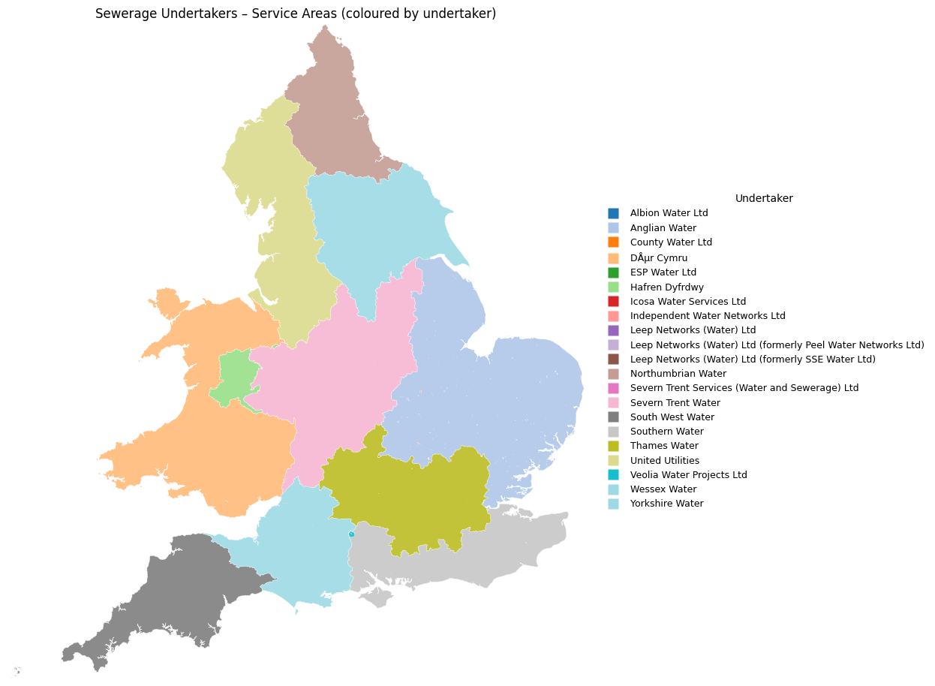
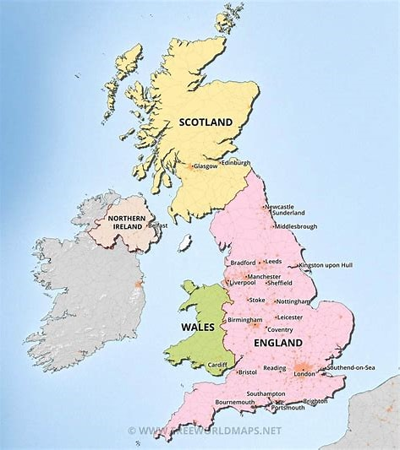
UK Sewerage Undertakers
Scotland & Northern Ireland are Government run Sewerage Undertakers . Wales has a “Not for Profit Organisation”. England- All English Sewerage Undertakers are profit seeking Businesses !

Slide 33
Google Alert terms
1. UK Water companies pollution incidents
2. Water UK /Wet wipes
3. Wet wipes Environmental concerns
4. Flushing wet wipes.
Tip: Set up a separate G-mail account- You can get a lot of Alerts.

Slide 35
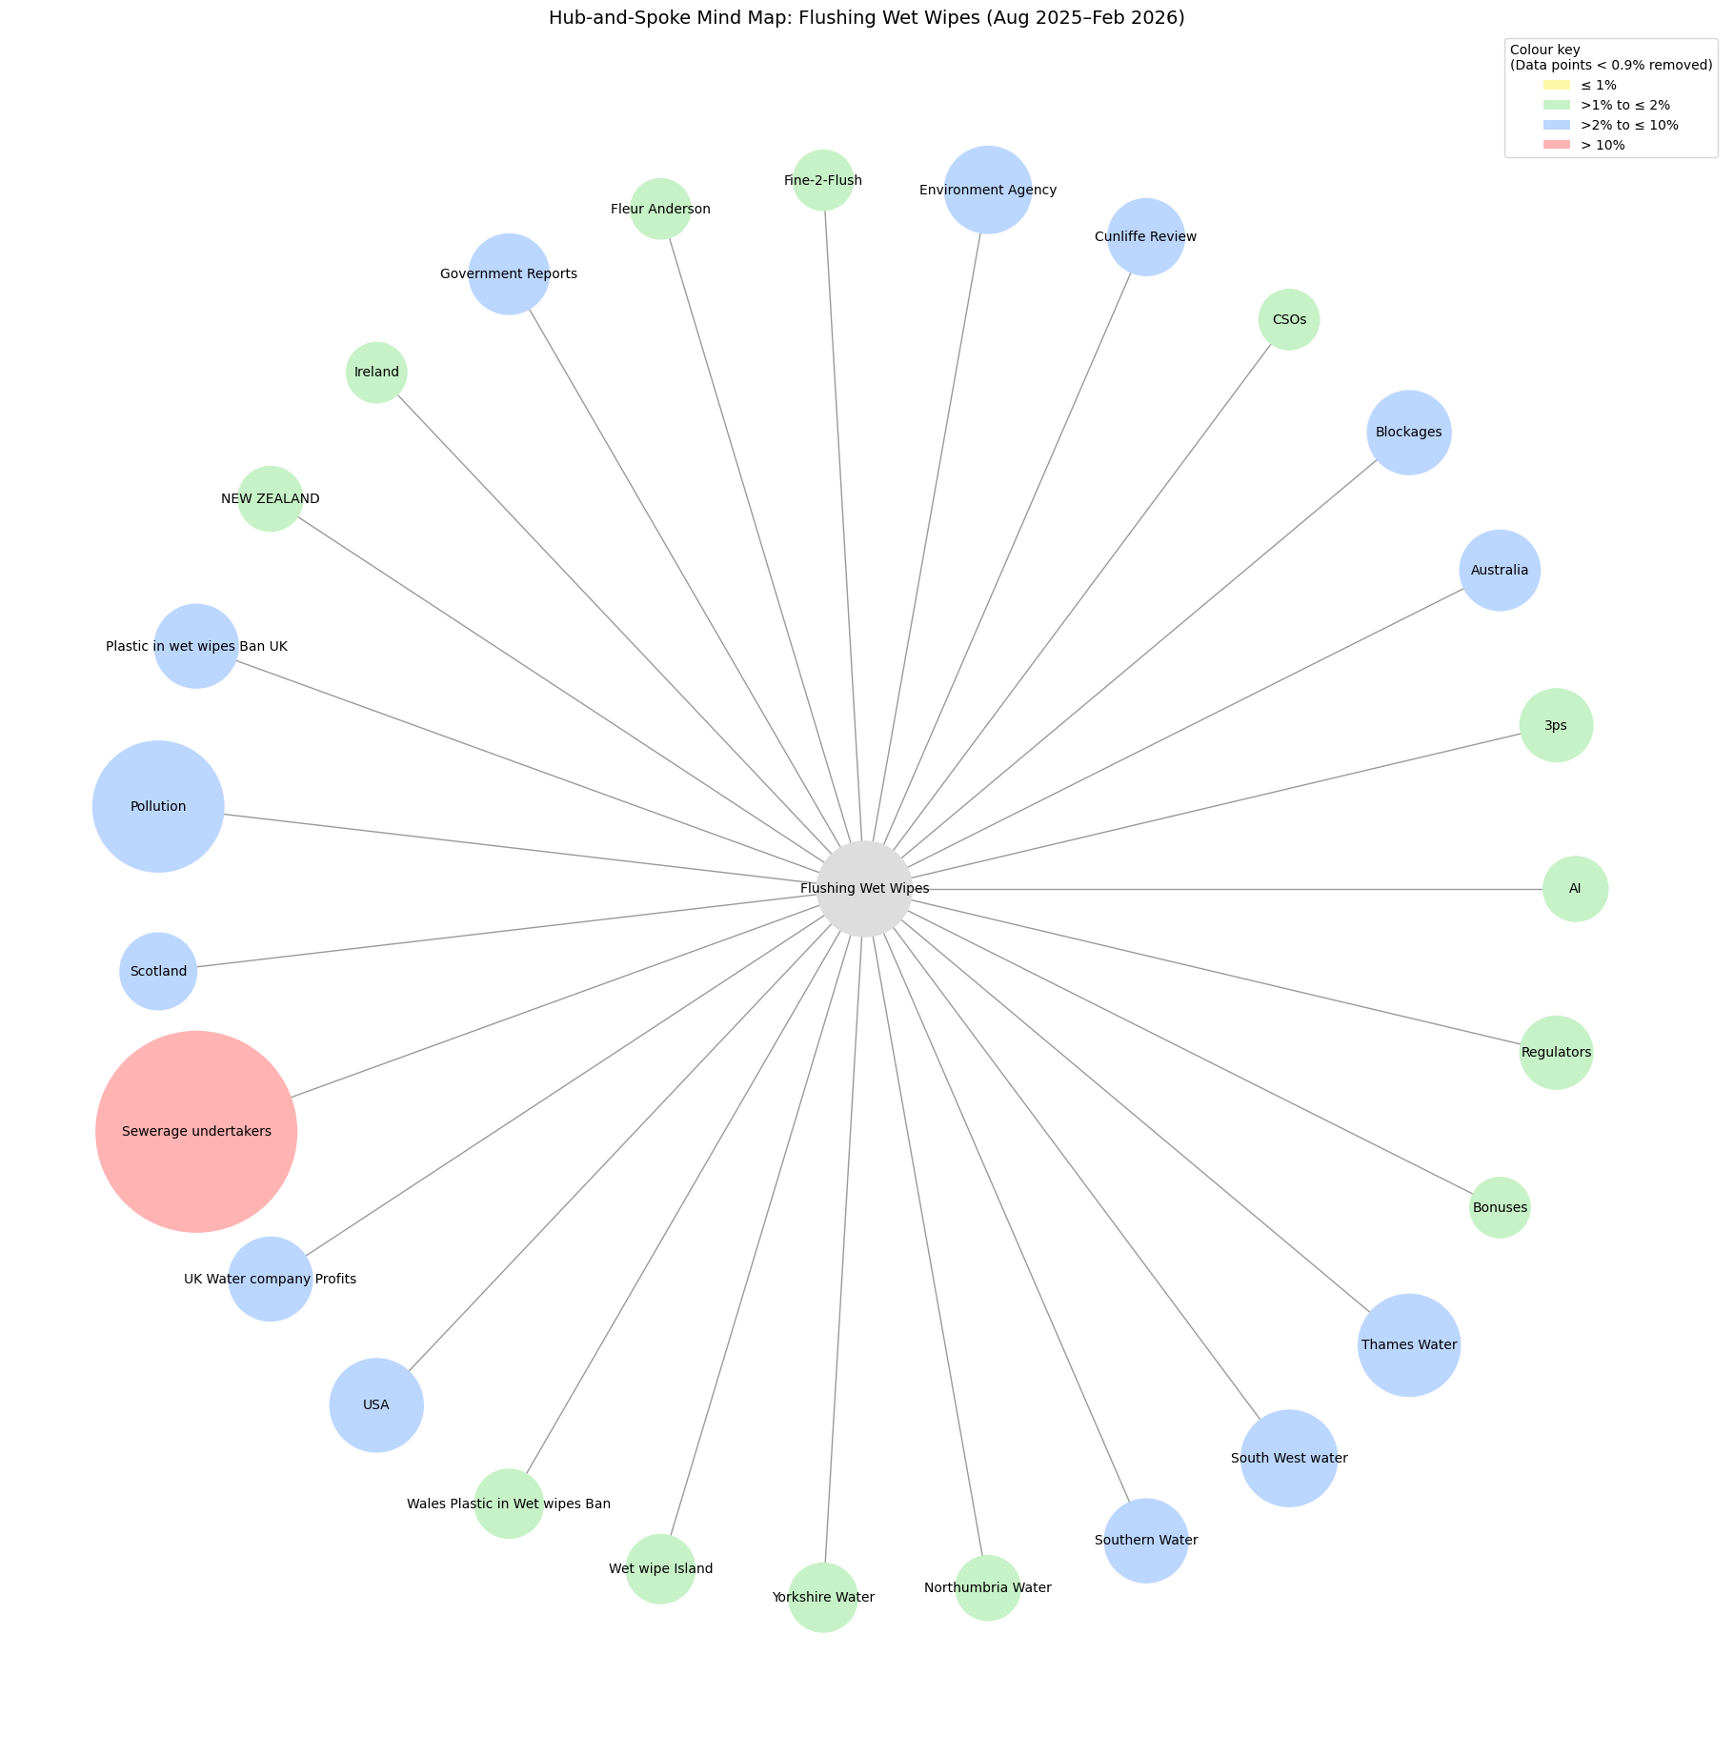

Slide 36
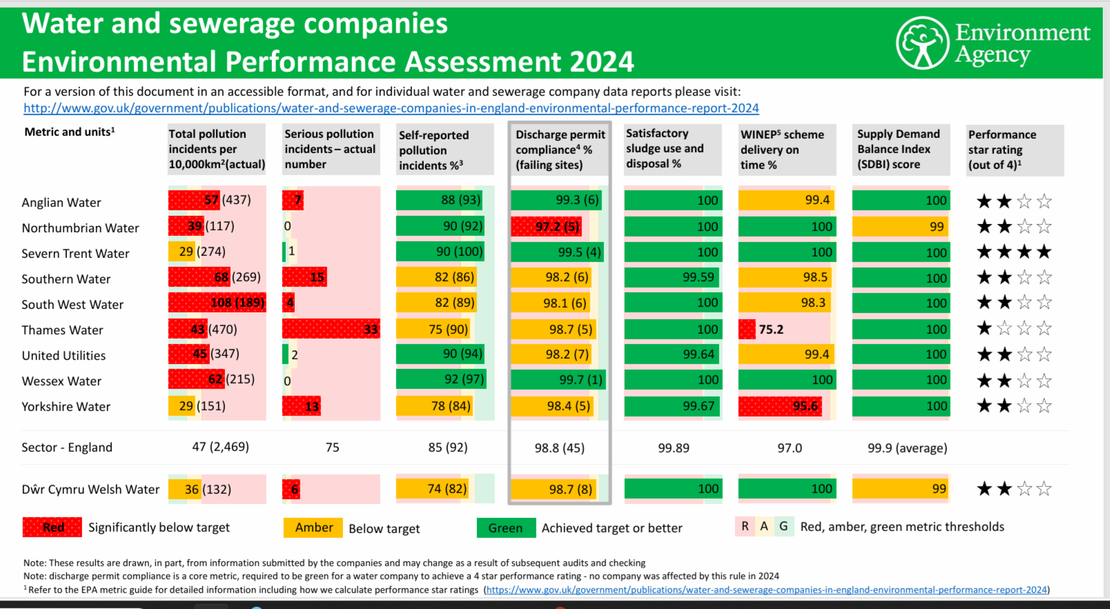
Environment Agency (England) Summary data 2024

Slide 37
In the UK the dog still has a bone. Look at the official minutes of the two houses of the UK Government. The House of Commons (03/11/2025) (Excerpts)
Source: https://hansard.parliament.uk/commons/2025-11-03/debates/5af90717-6363-47f1-9b3f-4badcfc9346b/DraftEnvironmentalProtection(WetWipesContainingPlastic)(England)Regulations2025
This action is part of a wider commitment to encourage more sustainable behaviours around the consumption of single-use plastic. Ultimately, we want to encourage a shift towards reusable and/or plastic-free alternatives
I worked with water companies across the UK so that the campaigning on this issue would be less confusing. It was “fine to flush” in some areas and there were different campaigns by different water companies. Now there is a unified effort by all the water companies together to have the same public messaging(Bin The Wipe). The main message must be: do not flush any wipes. No wipes are fine to flush.
Scotland has plans to bring this measure in soon, and in November 2024 the Northern Ireland Executive notified the World Trade Organisation of their intent to legislate. We look forward to the Northern Ireland Executive introducing their regulations as soon as possible, so that the whole of the United Kingdom is lined up on this issue.
I support the hon. Member for Putney and her injunction that people should stop flushing wet wipes down toilets. Unfortunately, this statutory instrument does not address that. I think the Minister could have taken the opportunity to impress upon the public that they must stop flushing
wet wipes down into the sewage system. They cause incredible blockages, which cost millions of pounds to clear, put our water bills up, and pollute the environment. Even if there are no plastics in them, they will continue to cause that nuisance. We must not let it get into the consumer’s mind, “Oh, these are plastic-free, so I can flush them down the loo.” I put it to the Minister that that is a great danger.
I am extremely pleased to support the draft regulations, but I call on the Government to do more to tackle microplastic pollution in our waterways and improve labelling to ensure that single-use wet wipes are clearly marked “Do not flush”, as so many hon. Members this evening have highlighted.

Slide 38
In the UK the dog still has a bone. Look at the official minutes (HANSARD)of the two houses of the UK Government. The House of Lords (10/11/2025)(excerpts)
Source : https://hansard.parliament.uk/Lords/2025-11-10/debates/9A4F2967-D9A2-40D4-9B58-5253BD927504/EnvironmentalProtection(WetWipesContainingPlastic)(England)Regulations2025
This is part of a wider commitment to encourage more sustainable behaviour around the consumption of single-use plastic. Ultimately, we want to encourage a shift towards reusable and/or plastic-free alternatives.
However, we will consider banning manufacture once the ban on supply and sale has come into force.
I take this opportunity to state that wet wipes should be binned, not flushed, regardless of whether they are plastic or plastic-free. When wrongly flushed, these products contribute to sewer blockages, which cause environmental harm, including pollution incidents and sewer flooding. The Government are supportive of campaigns that encourage the correct disposal of wet wipes, including Water UK’s Bin the Wipe campaign, and of industry action and innovation in this space
Manufacturers must be called to account and stop labelling wet wipes as flushable or disposable. They must be improved with clear and precise labelling, because misleading labelling makes misleading claims and causes confusion with the general public—ultimately, we see blockages in sewers, flooding and environmental damage triggering storm overflows, as well as harm to marine and animal health. It is imperative that action is taken to reduce the amount of microplastics entering our waterways and destabilising our marine ecosystems. Labelling is non-negotiable. It has to change, with clear labelling saying: “Do not flush”.
I have seen different figures but at least two-thirds—perhaps more—of the wet wipes being sold now do not contain plastic. This is not going to solve the sewage problem; that is terribly clear.
Can the Minister say what further measures the Government are considering? I know that there is a three-year review under this SI, but that is three years more of the kind of damage and human and environmental suffering that I have been talking about The Minister referred to the extended producer responsibility scheme; surely we could include all wet wipes in that now.
I have a specific question. I note that the impact assessment refers to plastic using the UK REACH definition, but the Marine Conservation Society has a specific question about whether lyocell and viscose are recognised as a form of plastic under that definition. The Marine Conservation Society says very clearly that they should be recognised as such because that is how they behave
A ban on plastic in wet wipes is welcome but, in terms of labelling, is it not time for all wet wipes to be classed as unflushable and for that to be said in large lettering on their packages?
Even so-called plastic-free wipes are not a simple solution. Whether they are made from cotton, bamboo or viscose, they remain single-use products with significant environmental footprints and the liquids they contain often include palm oil or chemical preservatives that can damage our rivers.
Lady Bennett, also asked about further action and why we are not going further and banning all wet wipes. Once we have implemented this, we will continue to review the evidence to determine whether we need any further action. The noble Baroness also mentioned extended producer responsibility. As she said, the Independent Water Commission recommended that the Government report on whether an extended producer responsibility scheme would be necessary to fund upgrades to water infrastructure. I reassure her that we are currently considering those recommendations and work is under way to investigate the necessity of an EPR scheme for wastewater in the UK. That work is taking place A number of noble Lords mentioned labelling. Mandatory labelling was not included in the 2023 consultation, and it is therefore not included alongside the ban, but we will consider whether it will be required to prevent wet wipes and other un-flushables being wrongfully flushed. We will also consider whether we need to include mandatory product labelling or an extended producer responsibility scheme to stop the wrongful flushing of wet wipes.

Slide 39
UK Environment Secretaries Since 2010 (it is a hot seat/ high churn)
Environment Secretary | Party | Tenure | Duration | Prime Minister(s) | Fine-2-Flush | Covid Pandemic UK
Caroline Spelman | Conservative | 12 May 2010 - 4 Sep 2012 | 2y 3m 23d | David Cameron
Owen Paterson | Conservative | 4 Sep 2012 - 14 Jul 2014 | 1y 10m 10d | David Cameron
Liz Truss | Conservative | 15 Jul 2014 - 14 Jul 2016 | 1y 11m 29d | David Cameron
Andrea Leadsom | Conservative | 14 Jul 2016 - 11 Jun 2017 | 10m 28d | Theresa May
Michael Gove | Conservative | 11 Jun 2017 - 24 Jul 2019 | 2y 1m 13d | Theresa May | Launch January 2019
Theresa Villiers | Conservative | 24 Jul 2019 - 13 Feb 2020 | 6m 20d | Boris Johnson | Northumbria Water initiates “Bin the wipe campaign” | First instance January 2020
George Eustice | Conservative | 13 Feb 2020- 6 Sep 2022 | 2y 6m 24d | Boris Johnson |  | Domestic restictions lifted February ,2022
Ranil Jayawardena | Conservative | 6 Sep 2022 -25 Oct 2022 | 1m 19d | Liz Truss
Thérése Coffey | Conservative | 25 Oct 2022 -13 Nov 2023 | 1y 19d | Rishi Sunak | February,2023 Bin the wipe UK national campaign launched by Water UK
Steve Barclay | Conservative | 13 Nov 2023 - 5 Jul 2024 | 7m 22d | Rishi Sunak | Ends March 2024
Steve Reed | Labour | 5 Jul 2024 - 5 Sep 2025 | 1y 2m 0d | Keir Starmer
Emma Reynolds (incumbent) | Labour | 5 Sep 2025 - present |  | Keir Starmer
(a) Fine-2-Flush certification 5 years, 2 months (b) UK Covid-19 restrictions 2 years, 1 month-
Additionally the Environment is a “devolved matter” across the constituent parts of the UK ( Welsh Government, Scottish Government, Very high turnover of UK Environment secretaries

Slide 40
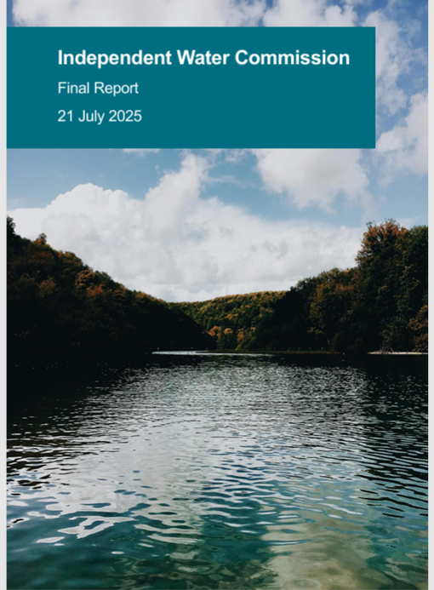
Independent Water Commission
Key Findings – Final Report
(21 July 2025)
https://www.gov.uk/government/publications/independent-water-commission-review-of-the-water-sector

Slide 41
Key Findings of the Independent Water Commission. 88 recommendations
1. Fragmented Responsibilities:
- Multiple organisations manage drainage and wastewater, causing inefficiency.
2. Aging and Inadequate Infrastructure:
- Existing systems are outdated and vulnerable to overload.
3. Storm Overflows and Pollution:
- Over 100,000 overflow incidents in 2023 raised public concern.
4. Poor Public Confidence:
- Distrust in governance, regulation, and corporate performance.
5. Climate Change and Urbanisation:
- Growing environmental pressures worsen system stress.
6. Missed Opportunities for Nature-Based Solutions:
- SuDS and green infrastructure underused despite benefits.

Slide 42
IWC specifically on Wet wipes
Special Focus: Wet Wipes
The Commission specifically addressed the environmental impact of wet wipes as part of its work on wastewater, drainage, and pollution reduction.
Key Points:
Wet wipes, many of which contain plastics, are a significant cause of sewer blockages, contribute to “fatbergs,” and release microplastics into waterways.
They enter sewers either through incorrect disposal (flushing) or as litter that washes into drains and watercourses.
The Commission cited evidence from water companies, environmental groups, and local authorities showing that wet wipes are among the most common single-use items found in river and coastal clean-ups.
Recommendations on Wet Wipes:
Bans on Plastics in Wet Wipes – Endorse proposed UK-wide legislation to ban the sale of wet wipes containing plastic fibres.(Legislation in force in Wales December,2026, Draft English Legislation laid before the house on 16th September,2025,Probably in Force England April 2027).
Public Education Campaigns – Run sustained campaigns, coordinated with water companies, to change disposal behaviour and reduce sewer blockages.
Monitoring & Enforcement – Require water companies and local authorities to track wet wipe-related blockages and environmental pollution, reporting annually to regulators.

Slide 43
Direct Quotations from IWC final report
Concerns about the legislative framework for managing drainage and wastewater
Paragraph: 209. pp109 of main commission report.
“Consumer activity such as the flushing of wet wipes, sanitary products and pouring fats, oils and greases down the sink also adds significant pressures to sewerage capacity. EA data shows 40% of all pollution incidents in England in 2019-20 were caused by blockages and 60% of these were caused by wet wipes”(Environment Agency(2021)).
Recommendation 9: pp 446.
“The UK and Welsh governments should update and reform the(Urban Waste Water Treatment Regulation) UWWTR 1994 to deliver better outcomes and a more sustainable approach to drainage and wastewater management. This should involve reporting on whether an Extended Producer Responsibility scheme is needed for the water sector to fund necessary improvements”.
Delivery approach via a Bill and Primary legislation.

Slide 44
Direct Excerpts from IWC final report- “Pre-Pipe solutions”
Recommendation 10:pp 447.
Government should consider legislative changes to drive a more coherent approach to ‘pre-pipe’ solutions to stop pollutants and rainwater entering the system.
Delivery via a Bill and Primary legislation.
Paragraph: 217. pp.112 of the main commission report.
“Both UK and Welsh governments should explore further measures to support consumer behaviour change, particularly for wet wipes. The UK Government should legislate swiftly, in line with its commitment, to ban wet wipes containing plastic. The UK government committed to legally banning wet wipes containing plastic and should legislate swiftly to this end; in Wales legislation to ban plastic wet wipes has already been passed by the Senedd.(Nation Cymru,2025) Given the environmental impact of all wet wipes (not just plastic) and other ‘unflushables’, further work is needed, including on behaviour change campaigns with support from government, the water industry, eNGOs and other relevant bodies.(Briain O et al.(2020)). The Commission notes that some targeted campaigns have already proven effective, such as the initial roll-out of the ‘Bin the Wipe’ campaign by Northumbrian Water, estimated to reduce blockages by 52% in targeted areas its first 3 years.(Northumbrian Water(2023))
Recommendation 85 pp.463
Water companies should work with Water UK to disseminate innovation learnings across the water industry in England and Wales.
Delivery via : industry led initiative.
Recommendation 88:
An independent review of the follow up to the Commission’s report should be carried out in 2 years’ time.
Delivery via: Government review on implementation

Slide 45

UK GOVT Water White paper January 2026 UK (A blueprint for future water reform legislation)
We want to do better at addressing the root causes of pollution head-on. Therefore, we are proposing a shift in focus towards ‘pre-pipe’ solutions,
To enable this shift, we will ensure legislation, funding streams, and regulatory mechanisms support the delivery of pre-pipe solutions
We will also take stronger action to make sure the public are not inadvertently contributing to this pollution. We will do this by tackling sewer misuse to prevent sewer blockages, which will help maximise sewerage capacity, reduce pollution incidents, and sewer flooding.
We have already introduced legislation to ban wet wipes containing plastic, which will reduce plastic and microplastic pollution in our waters.
https://www.gov.uk/government/publications/a-new-vision-for-water-white-paper

Slide 46
UK Sewerage Undertakers – Wet Wipes & 3Ps Messaging- Only Pee, Poo and Paper is Flushable.
Sewerage undertaker | Says wipes are non-flushable? / 3Ps? | Own customer programme(s) | Promotes Water UK 'Bin the Wipe'?
Anglian Water | Yes – 3Ps only | Keep It Clear; Just Bin It | Yes
Northumbrian Water | Yes – 3Ps only | Bin the Wipe (own campaign) | Yes – originated BtW
Severn Trent | Yes – 3Ps only | Anti-blockages education | Yes
Southern Water | Yes – 3Ps only | Unflushables education | Yes
South West Water | Yes – 3Ps only | Love Your Loo; Think Sink | Yes
Thames Water | Yes – 3Ps only | Bin it – don’t block it | Yes
United Utilities | Yes – 3Ps only | Stop the Block; Think before you flush | Not explicit (refers to BtW research)
Wessex Water | Yes – 3Ps only | Love Your Drains; local BtW use | Yes
Yorkshire Water | Yes – 3Ps only | Bin it. Don’t block it | Not explicit
Dŵr Cymru Welsh Water | Yes – 3Ps only | Stop the Block | Mentions/supports BtW; main focus StB
Hafren Dyfrdwy | Yes – 3Ps only | Seasonal tips, blockages education | Not explicit (group is Severn Trent)
Scottish Water | Yes – 3Ps only | Nature Calls campaign | Not explicit (runs Nature Calls)
Northern Ireland Water | Yes – 3Ps only | Bag it & Bin it; Unblocktober | Not explicit
Behavioural insights: Sewer blockages are considered a “distributed socio material problem”- where little is known about the routines and practices through which unflushable products find their way into waste water systems
(Alda-Vidal et al. (2020)).

Slide 47

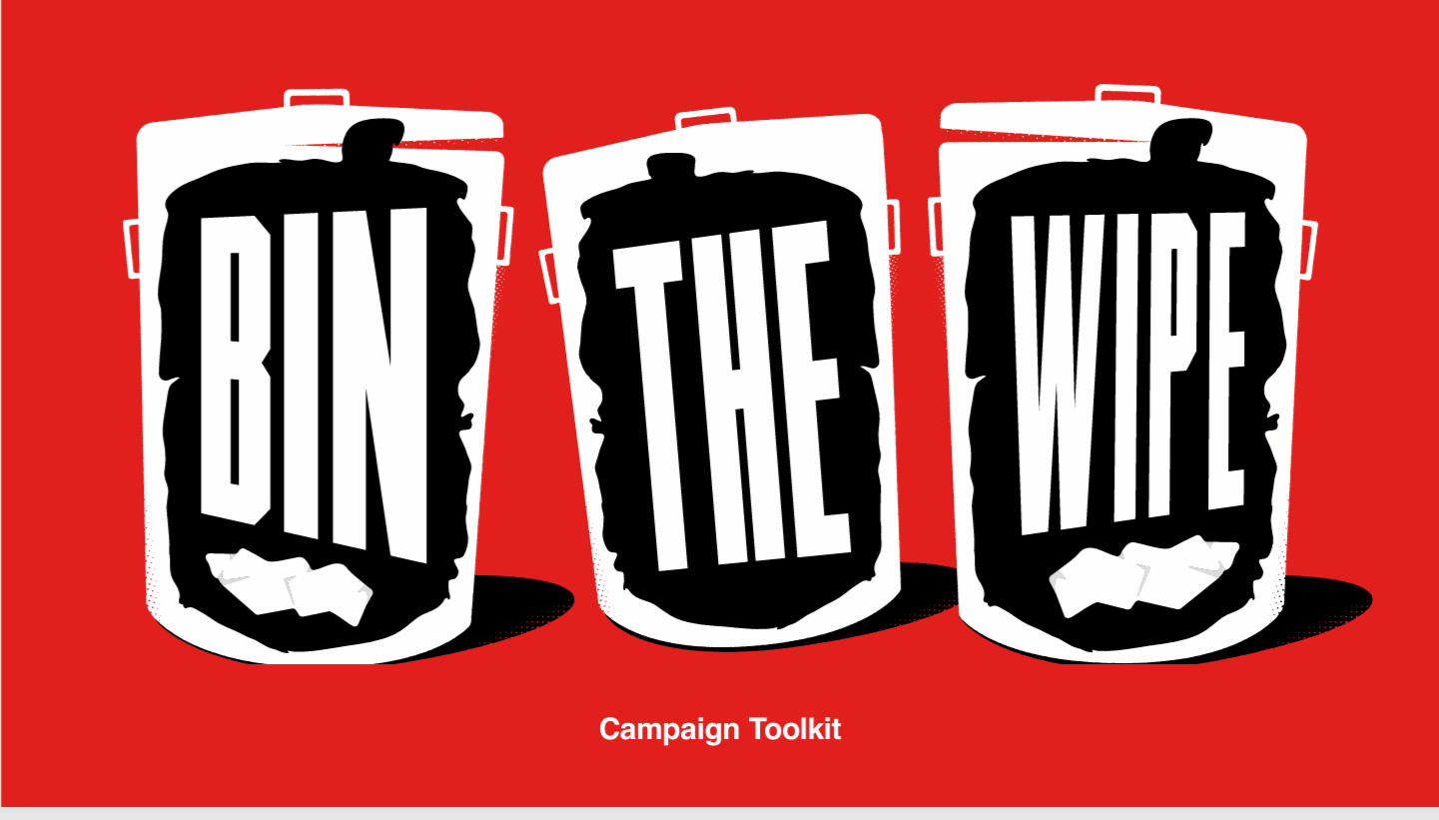
“Bin the Wipe: One Simple Change Makes a Big Difference”.
Campaign Highlights:
• Wet wipes cause up to £200m in blockages (UK)
• They don’t break down—leading to fatbergs, flooding, storm overflow pollution
• “When you use a wet wipe, bin it—not down the loo.”
Why This Matters:
• Prevents blockages, flooding & environmental harm
• Reduces sewage overflows to rivers and seas
• Protects wildlife from plastic pollution
Campaign Impact:
• National effort via Water UK & partners
• 41M+ impressions, 17M reached, 2M+ video views
Source: https://binthewipe.org (accessed March,2026)

Slide 48
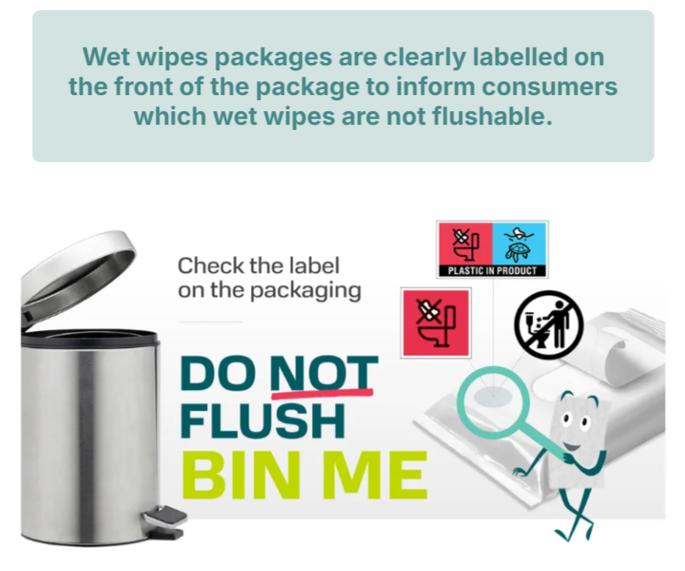
EDANA
Source: https://www.edana.org/how-we-take-action/wet-wipes-disposal (Accessed: March,2026)

Slide 49

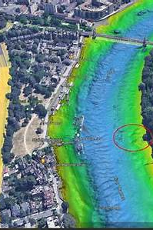
Source: Londonopia(2025)
Source: Thames 21(2021).
What Was Wet Wipe Island?
An environmental landmark in the River Thames, London. A “cultural landmark” that had its own google maps reference! (no longer there).

Slide 50
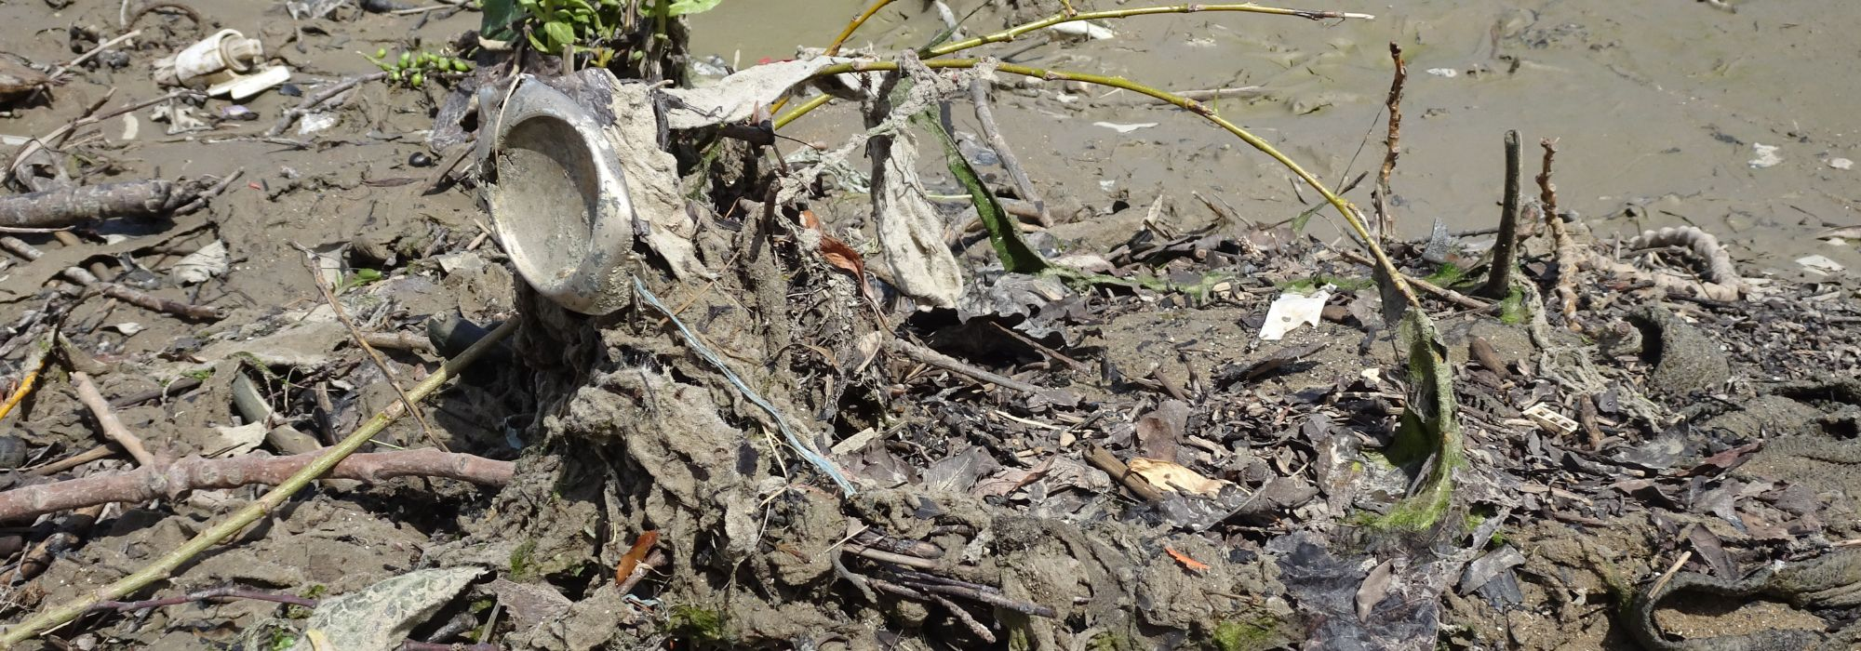
Source of image Thames 21(2025)
The Thames' Hidden Pollution Crisis
• ~180 tonnes of flushed wet wipes formed near Hammersmith Bridge. 820ft long and up to three feet high. • Equivalent to 15 double‑decker buses, covering two tennis courts. • Wipes clog together, altering river flow and harming ecosystems. • Volunteers removed 140,000 wipes since 2017. • 2025: first UK mass mechanical removal using 'rake & shake'. • UK plans to ban plastic‑containing wet wipes by 2026.
Investment in infrastructure -New “super sewer” built on time and to budget opened in spring 2025 “Thames tideway”- does not stope wipes being flushed but should address CSO issue.

Slide 51
UK Wet Wipes: Current Position (2025–2027) My thoughts
• UK-wide consensus(Excluding wipes manufacturers): only “pee, poo and paper” are flushable.
• All wet wipes (including plastic-free) contribute to sewer blockages, flooding, fatbergs and pollution incidents
• Unified national messaging: “Bin the Wipe” – no wipes are fine to flush
Legislation in place:
• Wales: ban on sale and supply of plastic-containing wet wipes (from 18 December,2026.
Northern Ireland :ban on sale and supply of plastic-containing wet wipes (from 18 May,2027)
• England: ban on sale and supply of plastic-containing wet wipes (from 19 May,2027)
• Scotland : on sale and supply of plastic-containing wet wipes (from 11 August 2027).
Key limitation:
• Plastic-free wipes still have the potential to cause blockages; bans alone do not solve sewer misuse

Slide 52

UK Future Policy & Legislative Direction my thoughts.
Key policy drivers:
• Independent Water Commission: ~60% of sewer blockages linked to wet wipes
• Shift toward “pre-pipe” solutions – stopping pollution before it enters sewers
Likely next steps (2026–2030):
• Mandatory, prominent “DO NOT FLUSH” labelling on all wet wipes
• Consideration of Extended Producer Responsibility (EPR) for wet wipes
• Potential further regulation of all wet wipes as unflushable products
• Integration into wider water and wastewater reform legislation
Strategic takeaway:
• UK policy has moved from improving flushability to keeping wipes out of sewers altogether
DO NOT FLUSH

Slide 53
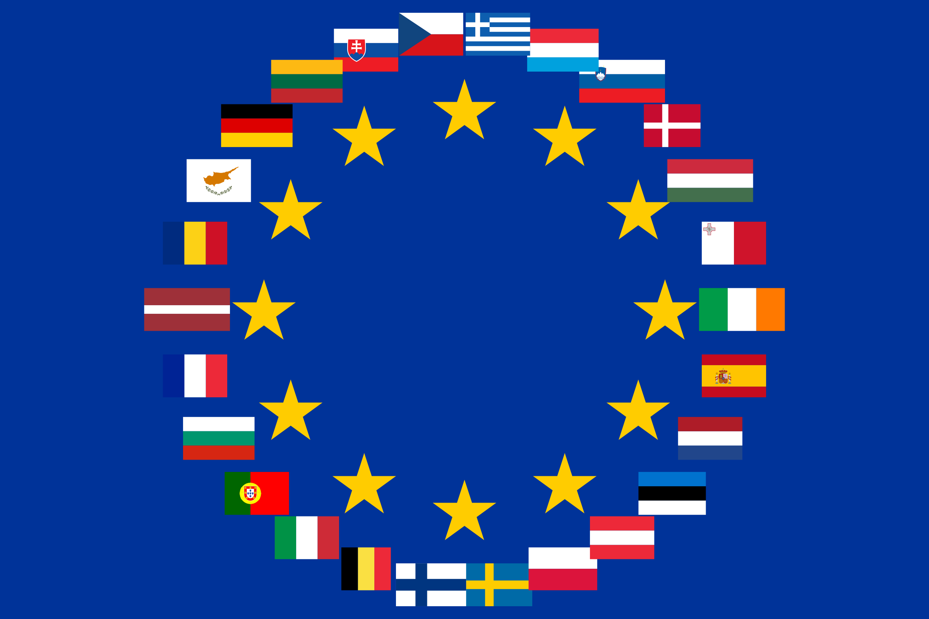
The European Green Deal — Key Highlights
A series of policy initiatives originated in 2019
Vision & Goal
• Transform EU into first climate‑neutral continent by 2050
• ≥ 55% GHG emissions reduction by 2030 (vs. 1990 levels)
Core Pillars / Focus Areas:
• Clean, affordable energy; renewables, modern grids, efficiency
• Industry & innovation: clean tech, circular economy
• Transport & mobility: low‑emission vehicles, sustainable logistics
• Biodiversity & environment: zero pollution, sustainable agriculture
• Just transition & social fairness: support affected regions & workers
• Carbon pricing & CBAM: fair global competition
Instruments & Financing
• European Climate Law (2050 neutrality)
• Just Transition Fund & Social Climate Fund
• NextGenerationEU, REPowerEU investments
• Expanded ETS and Carbon Border Adjustment Mechanism
Take‑away Message
The Green Deal integrates sustainability, competitiveness, and fairness — ensuring the green transition benefits people, nature, and businesses alike.
Thought process today: Progress to a circular economy has been too slow

Slide 54

EU Circular Economy Action Plan
Purpose & Rationale
• Shift from 'take‑make‑dispose' to circular model: keep resources in use, minimise waste
• Support climate neutrality & biodiversity; double material reuse to ~24 % by 2030
Key Measures
• Circular Economy Act (2026): single market for secondary raw materials “free movement of circular products, secondary raw materials &waste”.Stimulate demand for high quality recycled materials”
• Ecodesign for Sustainable Products Regulation (ESPR)(2024)
• Right to Repair Directive & green claims rules (2024)
• Packaging & Packaging Waste Regulation (2025)
• Batteries Regulation & Circular Textiles Strategy
• Reforms on end‑of‑life vehicles, waste shipments, microplastics restrictions
Implementation & Monitoring
• 54 actions under 2020 plan now in progress or completed
• 2023 Monitoring Framework: tracks circularity, material footprint & waste prevention
• Tools: EU Ecolabel, Green Public Procurement, Circular Economy Stakeholder Platform
Take‑away Message
A cornerstone of the Green Deal — driving innovation, sustainable production and consumption, and reducing Europe’s resource dependence.
However, the circularity rate in EU stagnant over last 15 years 10.7% in 2010 to 11.8% in 2023.
See: https://environment.ec.Europa.eu/strategy/circular-economy_en
(Accessed: October,2025)

Slide 55
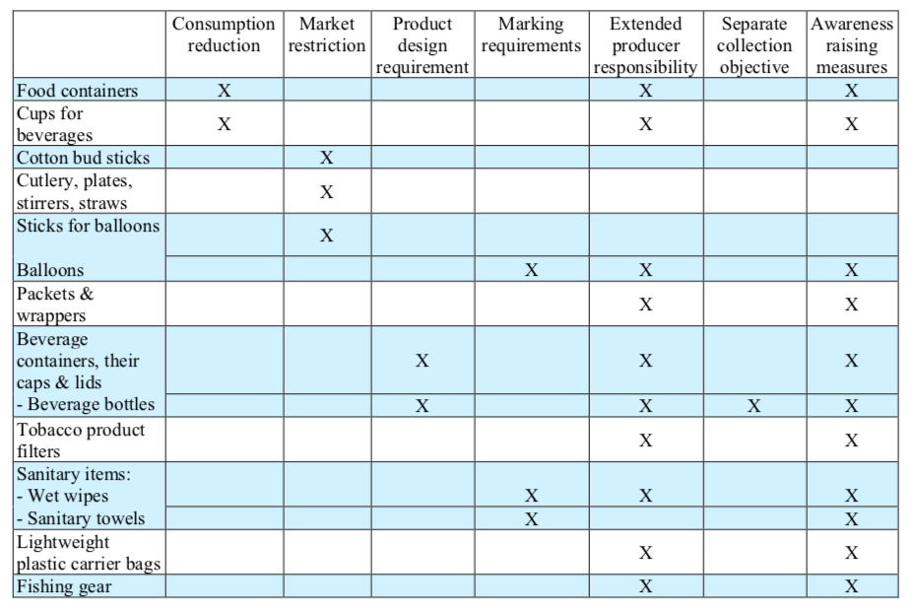
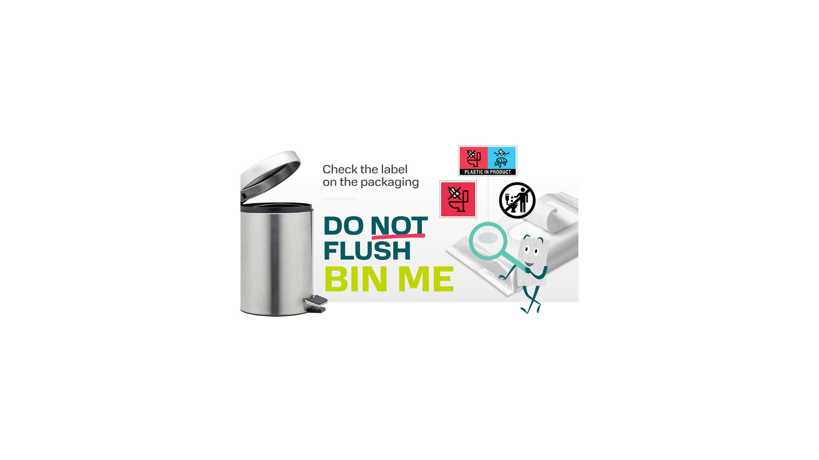





Single Use Plastics Directive 2019/904 Hygiene products impacted
https://www.edana.org/how-we-take-action/wet-wipes-disposal

Slide 56
Directive 2019/904 Single Use Plastics Directive: Evaluation /possible revision. (Stay close to European Trade Associations e.g. EDANA)
Must be EVALUATED by the EU Commission by 3rd July,2027 (Article 13 of Directive 2019/904)
Following the evaluation the commission may propose further measures including binding quantitative consumption reduction targets or other measures to strengthen the legislation.
The review is supposed to assess, among other things “Scientific and technical progress concerning criteria or a standard for biodegradability in the marine environment” applicable to single use plastic products.
The Directive sets up monitoring and reporting obligations ;member states must annually report on consumption, collection and implementation progress
This legal framework anticipates a review and a possible REVISION after 2027.
The commission could decide to amend , replace or supplement the Directive based on evidence and consultations.
Preparatory steps:
A Circular Economy Act – A consultation has been launched (August,2025)that may interplay with revisions to plastics and waste legislation more widely .
Any process to revise would follow normal EU legislative practice: the Commission would publish a proposal (or proposals), which would then go through the ordinary legislative procedure (i.e. co-decision by Parliament and Council) — unless a special procedure is used.
Prior to a formal proposal, the Commission generally launches public consultations, calls for evidence, surveys, impact assessments, and stakeholder hearings (this is standard practice for environmental and regulatory updates).
*** Formal evaluation and public consultation likely via the “Have your say portal” see:
https://ec.europa.eu/info/law/better-regulation/have-your-say_en

Slide 57
EPR Charges under SUPD for Plastic‑Containing Wet Wipes (Art. 8)
Charge category | Applies? | What it covers | Legal basis | Example implementation
Awareness‑raising measures | Yes | Consumer information and behaviour change campaigns | Art. 8(2)(a) | France – TSUU scheme funds public awareness
Public waste collection | Yes | Collection infrastructure, operation of public bins | Art. 8(2)(b) | Netherlands – per‑product EPR contribution
Transport & treatment | Yes | Transport and treatment of collected wipes | Art. 8(2)(b) | Included in Dutch clean‑up fee
Litter clean‑up | Yes | Street, park, and hotspot clean‑up + disposal | Art. 8(2)(c) | Netherlands – fixed clean‑up levy
Data gathering & reporting | Conditionally | Monitoring, reporting, verification | Art. 8 / 8a | Included in EPR administrative costs
Administrative / authorised representative | Indirect | Administration, registration, cross‑border representation | Art. 8(6)–(7) | Foreign producers appoint local rep
Under Article 8 of the Single‑Use Plastics Directive (EU) 2019/904, producers of plastic‑containing wet wipes must finance awareness measures, public waste collection, transport, treatment, and litter clean‑up costs. Fees are determined nationally (e.g., fixed per‑product charges in the Netherlands; eco‑organisation contributions in France).

Slide 58

France – EPR Scheme for Wet Wipes (Single‑Use Sanitary Textiles, TSUU)
🧾 **Legal Basis:** French Anti‑Waste & Circular Economy Law (AGEC, Law No. 2020‑105) establishes a new EPR stream for ‘single‑use sanitary textiles’, effective 1 Jan 2024.
🧴 **Scope:** Includes pre‑soaked wipes for personal, household, and surface cleaning (Category 1 of the TSUU stream).
🏛️ **Management:** Operated via an approved eco‑organisation (PRO) – *Citeo Soin & Hygiène* – responsible for registration, fee collection, awareness and reporting.
💶 **Eco‑contributions:** Producers pay fees based on declared volumes of wipes placed on the market. Rates vary by material & environmental performance (eco‑modulation).
🌍 **Producer Duties:** Register with ADEME (Unique IDU), appoint a French representative if non‑resident, label wipes with SUPD disposal icons, and report annual data.
🎯 **Targets:** Reduce single‑use wipe consumption by 15% by 2030 and finance awareness ,€2.5 M(pa) collection, and clean‑up (contribution varies on # inhabitants per area) measures.
⚖️ **Status:** Decree implementing the scheme under consultation (2024‑2025); full rollout expected in 2025.
The French EPR on WW has several facets to it:
The PRO will have to contribute funds to R&D projects focused on developing more alternative solutions to WW and on supporting investments in reuse systems € 2.5M (pa). The funds will be contributed in increasing amounts year-by-year as seen below:
– 375000 € en 2025;
– 750000 € en 2026;
– 1125000 € en 2027;
– 1500000 € each year from 2028

Slide 59
Why the Netherlands Did Not Ban Wet Wipes (Feb 2025)
Proposal: National ban on plastic-containing wet wipes to reduce sewer blockages and plastic pollution
Decision: A narrow majority (73 to 72 votes !) in the Dutch parliament blocked the proposed ban
Reasons: Considered disproportionate and going beyond existing EU requirements; focus should be on disposal behaviour
Outcome: No national ban adopted; government shifted focus to EU-level regulation

Slide 60
Republic of Ireland: Wet Wipes Regulation – Signals vs Reality
Market & Media Signals: • Irish media and policy commentary (2023–2025) has suggested Ireland *may* follow the UK’s lead in banning plastic-containing wet wipes. • Commentary largely driven by UK action, marine litter concerns, and sewer blockage impacts.
What Ireland Is Actually Doing Now: • No announced or legislated ban on the sale of plastic-containing wet wipes. • Wet wipes containing plastic are included in Extended Producer Responsibility (EPR) schemes. • Producers contribute to litter clean-up costs and comply with EU Single-Use Plastics labelling requirements.
Context for Suppliers: • Regulatory pressure exists, but Ireland remains aligned with EU framework rather than UK-style bans. • UK bans (England, Wales, Scotland) remain the primary immediate market driver for fibre substitution.
https://www.independent.ie/irish-news/will-ireland-follow-uks-lead-and-ban-plastic-containing-wet-wipes/a50661859.html

Slide 61

Portugal: Wet Wipes – Policy & Market Developments
Policy Drivers (SUP context)
NGO(Quercus) campaign for ban on non‑biodegradable wipes
Sewer blockages & marine litter impacts
Call for national awareness measures (Art.10‑type)
EPR cost recovery for wastewater costs
Implications for Industry
Product redesign to meet "genuine biodegradability"
Potential EPR fees linked to wastewater
Mandatory labelling & consumer communication
Need for proactive transition planning
“It is necessary to raise public awareness about this problem and promote more responsible behaviour,” says Quercus which will have been buoyed in this endeavour by practices in other countries – specifically the UK, where non-biodegradable wet wipes are being banned from next year. See: https://www.portugalresident.com/ngo-wants-ban-on-non-biodegradable-wet-wipes/

Slide 62
🇬🇧 EUDR and Its Importance for the UK (could be the same for Vietnam – but please check.
🇬🇧 Why It Matters for UK Businesses • The UK is not legally bound but is commercially affected — EU buyers need full traceability data. • UK firms must share supply chain information early so EU customers can file DDS. • Northern Ireland follows EUDR under the Windsor Framework. • Compliance has become a market access requirement, not just an environmental measure. • Applies to raw materials and finished goods, including packaging( e.g. corrugate case flats(but not items boxed in packaging). 🆕 Recent Developments (October 2025) • EU announced targeted simplifications: - One DDS per supply chain. - Simplified one-off declarations for small operators. - Large firms get six-month grace period (to June 2026). • Critics warn of weakened enforcement, but EUDR remains a key EU climate policy. ✅ Key Takeaway Even outside the EU, UK businesses must align with EUDR traceability standards to retain EU market access and prove deforestation-free supply chains.
** Useful information for UK Businesses but could be useful for Vietnamese business- “INTERU”(end to end traceabilty platform organisation) see: https://www.interu.io/blog/how-to-tell-if-your-products-fall-in-scope-of-the-eudr

Slide 63
Key take home messages:
In Europe we need to work together- “wastewater” and the “manufacturers” (the broad nonwovens industry). An independent facilitator body is probably needed to progress interaction.
UK Policy has moved from improving flushability to keeping wipes out of sewers altogether.
I see mandatory DNF labelling coming.
The USA with Responsible Flushing Alliance has done some excellent work. Learnings / awareness raising could usefully be transferred. See: https://flushsmart.org
While hygiene products offer important societal benefits, it is equally important that we promote and advocate for their correct and responsible disposal

Slide 64

THANK YOU !
Any Questions?
David E. James LLM, PgDip, ScsDip, MIMMM, APkgPrf, Ctext, ATI 📱 +44 7881 940067
✉️ David@davidejamesconsulting.co.uk
🌐 https://davidejamesconsulting.co.uk
💼 Enquiries@davidejamesconsulting.co.uk
📅 https://calendly.com/david-davidejamesconsulting/new-meeting-2
📅 https://calendly.com/david-davidejamesconsulting/new-meeting

