Slide 1


Slide 2
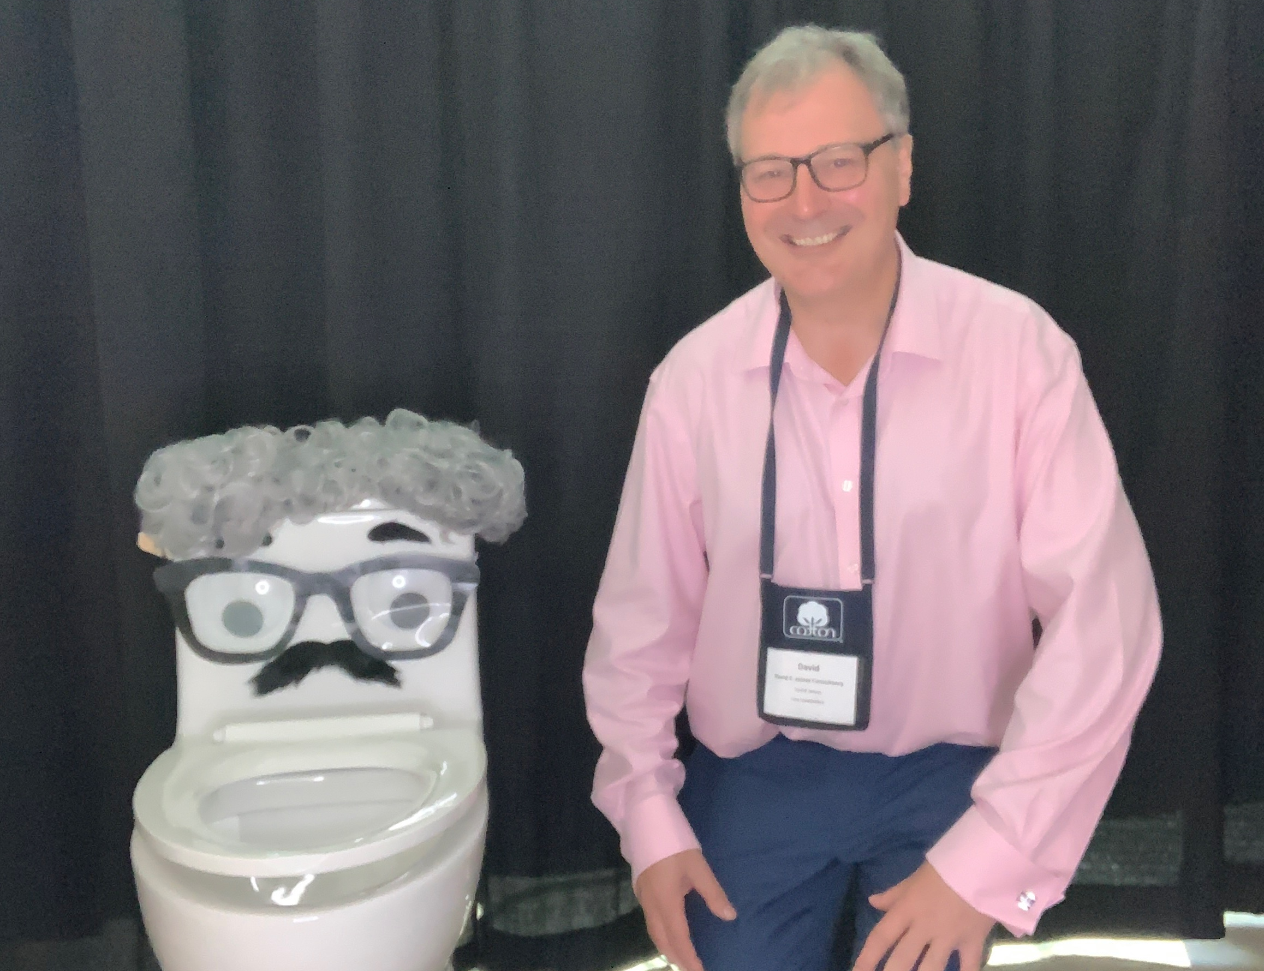

M: +447881940067
E: David@davidejamesconsulting.co.uk
W: https://davidejamesconsulting.co.uk
Enquiries@davidejamesconsulting.co.uk
  The views expressed in this presentation are my own and do not reflect any organisation / body. I am not expressing any views on behalf of or reflective of the GB delegation to ISO TC224WG10.
  David has collaborated with external agencies and trade associations for advocacy and promoting industry standards and best practice. David has chaired the EDANA (European disposables and nonwovens association) Wet wipes working group during 2020-2022. He currently sits on an ISO technical committee working group ISOTC224 WG10 “on Flushable products”.
  David has successfully developed products that are fabricated with sustainable alternatives to traditional nonwoven and packaging materials as used in the wet wipes industry.
  Qualifications and professional Associations:
  David has a Master of Laws in Environmental Law and Practice (Leicester De-Montfort), a Postgraduate Diploma in Packaging Technology (Brunel / Loughborough).
  David is a Fellow and Chartered member of the Textiles institute and a chartered member of the Institute of Materials Minerals and Mining and has achieved Accredited packaging professional status.
  In 2023 David set up his own consultancy business DAVID E. JAMES CONSULTANCY LIMITED that leverages David’s 30+ years of industrial / research experience to provide expertise in the key areas of wipes production (including GMP) ,raw materials sourcing, process efficiency and sustainability for personal care , domestic use and professional use type

Slide 3
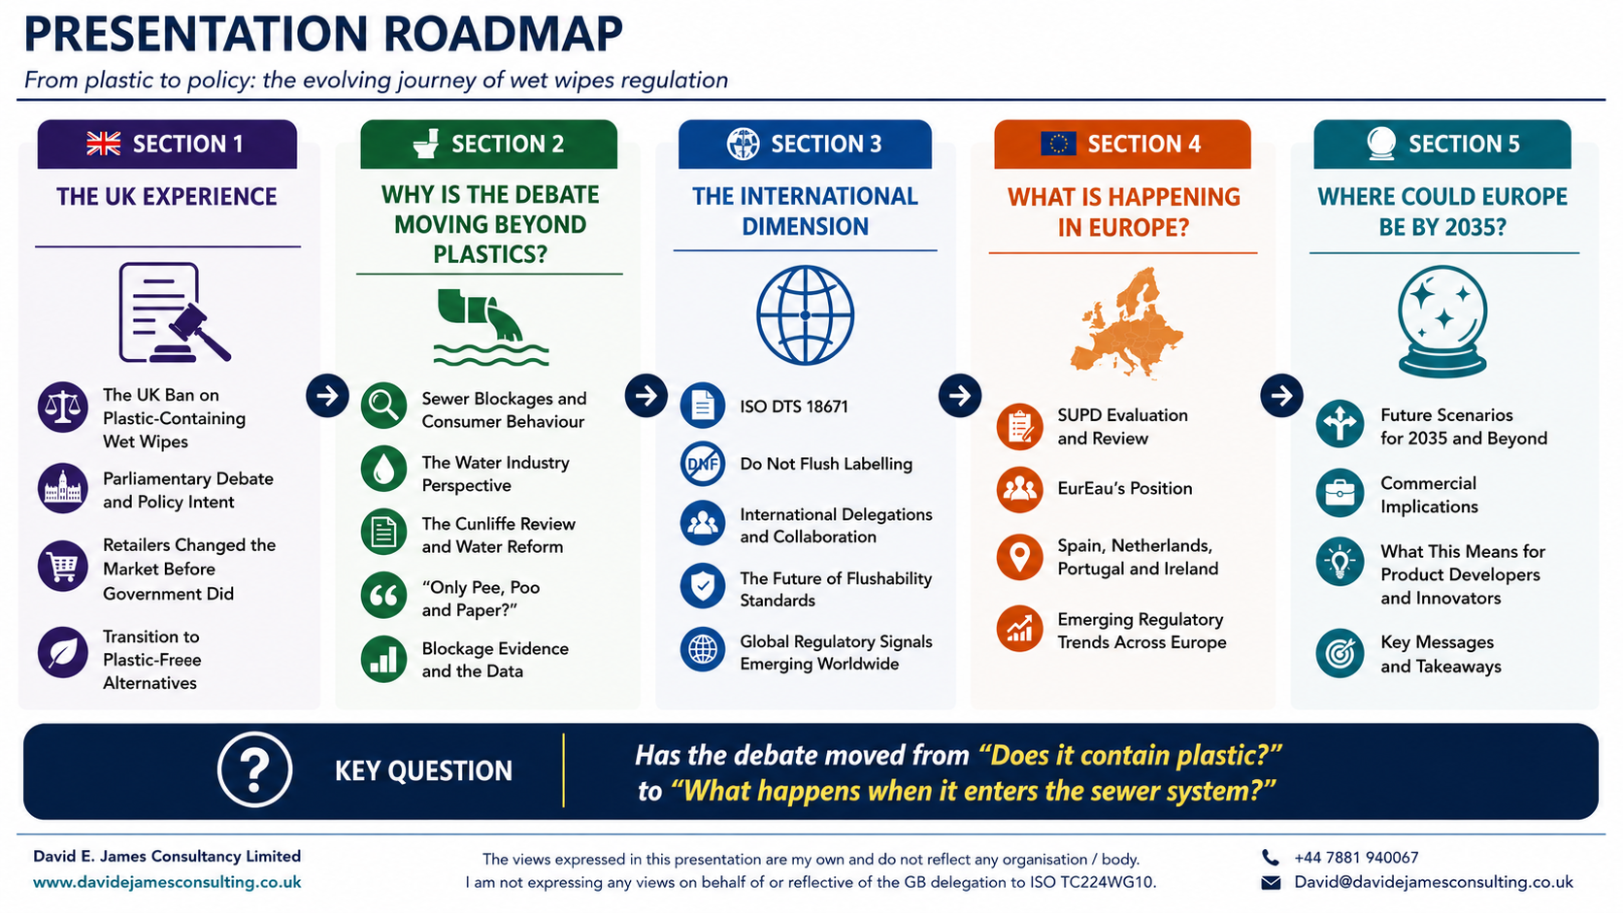

Slide 4

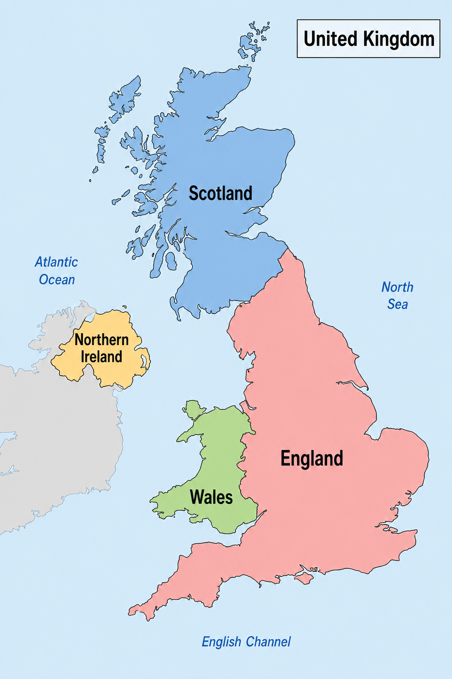
The United Kingdom of Great Britain & Northern Ireland

Slide 5








The individual 4 nations Regulations of the UK
But not manufacture !
Jurisdiction | Title of Regulations | Statutory Instrument No. | Made (year) | Entry into force | Core prohibition | Key exemptions | Notable features
Wales | The Environmental Protection (Single-use Plastic Products) (Wet Wipes) (Wales) Regulations 2025 | SI 2025/716 (W.124) | 2025 | 18 Dec 2026 (GOV.WALES) | Ban on supply (including free supply) of plastic-containing wet wipes to consumers | Medical-use wipes | Earlier implementation; framed under broader single-use plastic products regime
England | The Environmental Protection (Wet Wipes Containing Plastic) (England) Regulations 2025 | SI 2025/1218 | 2025 | 19 May 2027 (GOV.UK) | Ban on sale and supply to end users | Medical use; pharmacy sales under restrictions; business-to-business supply | More detailed retail restrictions (e.g. pharmacy display rules) Most operationally detailed regime
Scotland | The Environmental Protection (Wet Wipes Containing Plastic) (Scotland) Regulations 2026 | SSI 2026/75 | 2026 | 11 Aug 2027 The Environmental Protection (Wet Wipes Containing Plastic) (Scotland) Regulations 2026 | Ban on supply to consumers/end users | Expected: medical and similar exemptions | Latest commencement date; mirrors England model closely
Northern Ireland | The Environmental Protection (Wet Wipes Containing Plastic) Regulations (Northern Ireland) 2025 | SR 2025/178 | 2025 | 18 May 2027 The Environmental Protection (Wet Wipes Containing Plastic) Regulations (Northern Ireland) 2025 | Ban on sale and supply of plastic wet wipes | Medical use; aligned with UK approach | Closely aligned timing with England

Slide 6

Where the 4 Regulations align
Area | Common Position Across Wales, England, Scotland & Northern Ireland
Policy objective | All aim to reduce plastic pollution, particularly microplastics entering waterways and marine environments
Products in scope | All cover wet wipes containing plastic, including personal care, cosmetic, and cleaning wipes
Core restriction | All prohibit the sale and/or supply to consumers/end users of plastic-containing wet wipes
Material distinction | All allow plastic-free (e.g. cellulose-based) wet wipes to remain on the market
Medical exemption | All provide exemptions for wet wipes used for medical or healthcare purposes
Territorial consistency | Regulations developed following a coordinated UK-wide policy approach
Enforcement model | Enforcement generally assigned to local authorities with inspection and penalty powers
Legal framework | All made under powers linked to the Environmental Protection Act 1990
Target actors | Focus on suppliers, retailers, and distributors, rather than consumers
Environmental rationale | All recognise wet wipes as a major contributor to sewer blockages and marine litter

Slide 7
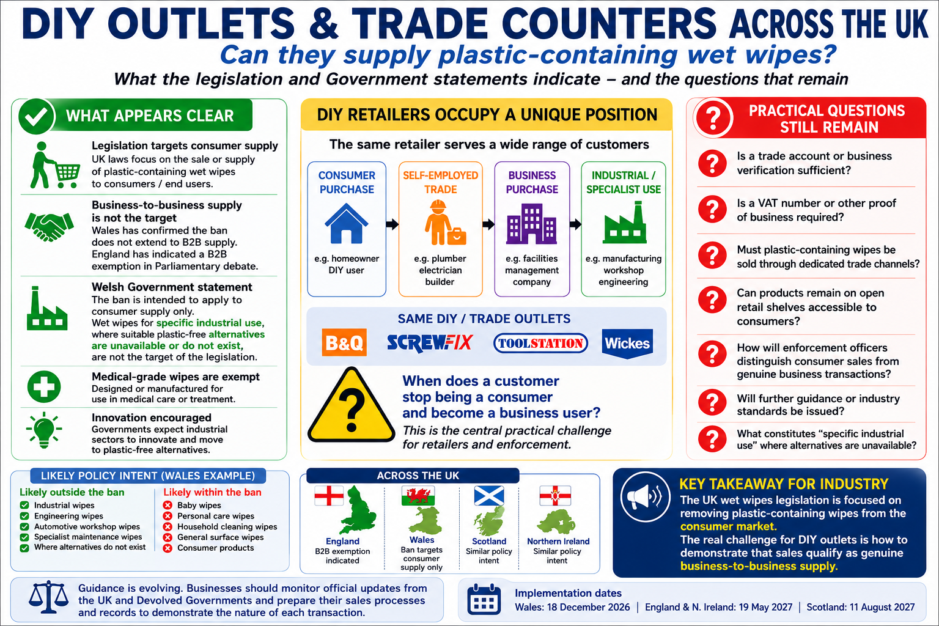

Guidance is not as well developed across the UK as it was in Europe for the EU Single use Plastics Directive

Slide 8


Pre-Ban Consultations on Plastic Wet Wipes (UK Nations)
Country | Consultations | Number | Main Reason | Leading Comments
England | Call for Evidence (2021); UK Consultation (2023) | 2 | Test policy support; move to ban | Strong support (~96%); concerns on sewer blockages, microplastics, misleading 'flushable' claims
Wales | SUP plastics consultation (Oct,2020) UK Consultation (2023) | 2 | Reduce single-use plastic pollution | Support for action; suggestions for EPR, better labelling, biodegradable alternatives
Scotland | Marine Litter Strategy; UK Consultation (2021 & 2023) | 2 | Address marine litter and sewage debris | Support for ban; calls for stronger and faster action; support for EPR
Northern Ireland | UK Consultation (2023) | 1 | Align with UK-wide environmental action | Strong support; need for medical/industrial exemptions
All UK Nations | Joint UK Consultation (2023) | 1 | Decide on ban scope and impacts | 95% support; concerns on costs, jobs, definitions; manufacture ban dropped
In the UK the Environment is a “Devolved power”, handled by the individual Government , assemblies etc. However, DEFRA (Department Environment, Food & Rural Affairs) lead the last consultation to give a harmonised UK approach

Slide 9
Look at the official minutes of the two houses of the UK Government. The House of Commons (03/11/2025) (Excerpts)- Total Cross party support across all four nations.
(Reference UK Parliament (2025))
“This action is part of a wider commitment to encourage more sustainable behaviours around the consumption of single-use plastic. Ultimately, we want to encourage a shift towards reusable and/or plastic-free alternatives”.
“I worked with water companies across the UK so that the campaigning on this issue would be less confusing. It was “fine to flush” in some areas and there were different campaigns by different water companies. Now there is a unified effort by all the water companies together to have the same public messaging(Bin The Wipe). The main message must be: do not flush any wipes. No wipes are fine to flush”.
“Scotland has plans to bring this measure in soon, and in November 2024 the Northern Ireland Executive notified the World Trade Organisation of their intent to legislate. We look forward to the Northern Ireland Executive introducing their regulations as soon as possible, so that the whole of the United Kingdom is lined up on this issue”.
“I support the hon. Member for Putney and her injunction that people should stop flushing wet wipes down toilets. Unfortunately, this statutory instrument does not address that. I think the Minister could have taken the opportunity to impress upon the public that they must stop flushing wet wipes down into the sewage system. They cause incredible blockages, which cost millions of pounds to clear, put our water bills up, and pollute the environment. Even if there are no plastics in them, they will continue to cause that nuisance. We must not let it get into the consumer’s mind, ). The main message must be: do not flush any wipes. No wipes are fine to flush”.
“I am extremely pleased to support the draft regulations, but I call on the Government to do more to tackle microplastic pollution in our waterways and improve labelling to ensure that single-use wet wipes are clearly marked “Do not flush”, as so many hon. Members this evening have highlighted”.

Slide 10
The House of Lords (10/11/2025)(excerpts). See UK Parliament. House of Lords(2025)
This is part of a wider commitment to encourage more sustainable behaviour around the consumption of single-use plastic. Ultimately, we want to encourage a shift towards reusable and/or plastic-free alternatives.
However, we will consider banning manufacture once the ban on supply and sale has come into force.
I take this opportunity to state that wet wipes should be binned, not flushed, regardless of whether they are plastic or plastic-free. When wrongly flushed, these products contribute to sewer blockages, which cause environmental harm, including pollution incidents and sewer flooding. The Government are supportive of campaigns that encourage the correct disposal of wet wipes, including Water UK’s Bin the Wipe campaign, and of industry action and innovation in this space
Manufacturers must be called to account and stop labelling wet wipes as flushable or disposable. They must be improved with clear and precise labelling, because misleading labelling makes misleading claims and causes confusion with the general public—ultimately, we see blockages in sewers, flooding and environmental damage triggering storm overflows, as well as harm to marine and animal health. It is imperative that action is taken to reduce the amount of microplastics entering our waterways and destabilising our marine ecosystems. Labelling is non-negotiable. It has to change, with clear labelling saying: “Do not flush”.
I have seen different figures but at least two-thirds—perhaps more—of the wet wipes being sold now do not contain plastic. This is not going to solve the sewage problem; that is terribly clear.
Can the Minister say what further measures the Government are considering? I know that there is a three-year review under this SI, but that is three years more of the kind of damage and human and environmental suffering that I have been talking about The Minister referred to the extended producer responsibility scheme; surely we could include all wet wipes in that now.
I have a specific question. I note that the impact assessment refers to plastic using the UK REACH definition, but the Marine Conservation Society has a specific question about whether lyocell and viscose are recognised as a form of plastic under that definition. The Marine Conservation Society says very clearly that they should be recognised as such because that is how they behave
A ban on plastic in wet wipes is welcome but, in terms of labelling, is it not time for all wet wipes to be classed as unflushable and for that to be said in large lettering on their packages?
Even so-called plastic-free wipes are not a simple solution. Whether they are made from cotton, bamboo or viscose, they remain single-use products with significant environmental footprints and the liquids they contain often include palm oil or chemical preservatives that can damage our rivers.
Lady Bennett, also asked about further action and why we are not going further and banning all wet wipes. Once we have implemented this, we will continue to review the evidence to determine whether we need any further action. The noble Baroness also mentioned extended producer responsibility. As she said, the Independent Water Commission recommended that the Government report on whether an extended producer responsibility scheme would be necessary to fund upgrades to water infrastructure. I reassure her that we are currently considering those recommendations and work is under way to investigate the necessity of an EPR scheme for wastewater in the UK. That work is taking place A number of noble Lords mentioned labelling. Mandatory labelling was not included in the 2023 consultation, and it is therefore not included alongside the ban, but we will consider whether it will be required to prevent wet wipes and other un-flushables being wrongfully flushed. We will also consider whether we need to include mandatory product labelling or an extended producer responsibility scheme to stop the wrongful flushing of wet wipes.

Slide 11



UK Market for Consumer/ retail Wet wipes- a journey
34 years in the wet wipes business. Consumer wet wipes: Sheet size reduction, basis weight reduction, adjust fibre ratios of blends, reduce pack count. Once luxury products now total COMMODITIES.
33 years ago- Baby Wet wipes – The dominance of Adhesive bonded airlaid 60 to 65 gsm “Thick wipes” .
30 years ago, the rise and ultimate dominance of Hydroentangled Spunlace for Baby wet wipes (Viscose / Polyester blends). 55 gsm- 60 gsm. Typical sheet size 203 mm x 178 mm (8”x7”(USA)) or 0.036 sqm
Data from just under 2 years ago (2024)- random “Snapshot” selection of packs of plastic free wet wipes taken from UK retail shelves n>50 over: Including Baby wipes, Hard surface & Floor cleaning wipes, Skin Cleansing wipes.
14th March 2022 –Tesco Stores – All branded and own brand wet wipes are plastic free. All own brand Tesco wet wipes had been plastic free since 2020.
Aldi switches all own label wipes to plastic free in summer 2022.
SO PREDATING ANY BAN ON PLASTIC CONTAINING “CONSUMER” WET WIPES.
Material | Frequency | %
Viscose | 41 | 80.39%
Lyocell | 2 | 3.92%
Pulp & Viscose | 5 | 9.80%
Pulp & Lyocell | 3 | 5.88%

Slide 12
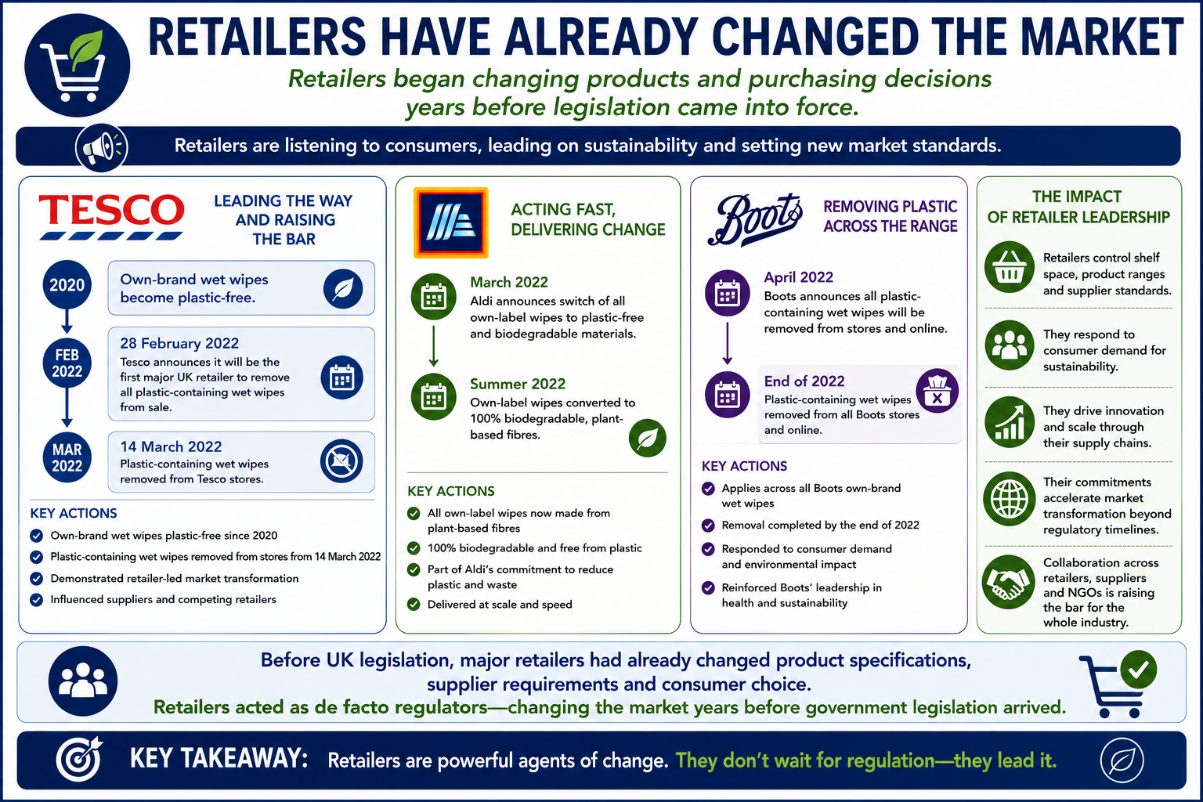


4
6
1
Rank order- Relative Importance in UK Wet Wipes Market e.g. Baby wet wipes.
FYI :Tesco now captures almost one-third of UK grocery spending and approximately £1 in every £10 spent across UK retail

Slide 13



What types of wet wipe materials are being supplied to the UK retail Market in 2026?
Commodity – “boring” 100% viscose wipes – 40/45/50 gsm
A little C/P
Performance and pricing show marginal differences between the two alternatives
Yet meets customer need and pricing
Pricing driven down by “discount retailers” – e.g. Aldi.
“Price match” against Aldi offered by other retailers ( See: Which?(2025))

Slide 14
Policy trajectory (banning plastic in wipes) cannot be understood through material substitution alone.
House of Lords(2025) – “I have seen different figures but at least two-thirds—perhaps more—of the wet wipes being sold now do not contain plastic. This is not going to solve the sewage problem; that is terribly clear”
The voice of Non-Governmental Organisations (NGO’s) e.g. “Marine Conservation Society”, “Flora and Fauna” , “Thames 21”.
The Voice of the UK Water Industry- However it is fair to say the UK General public has LOST TRUST in the UK water industry. Arguably the UK Government had lost trust in the UK Water Industry as well:
1.The Independent Water Commission (aka) The Cunliffe Review (July 2025)
2.The Government Response to the Cunliffe Review (January 2026)- a “White Paper”

Slide 15
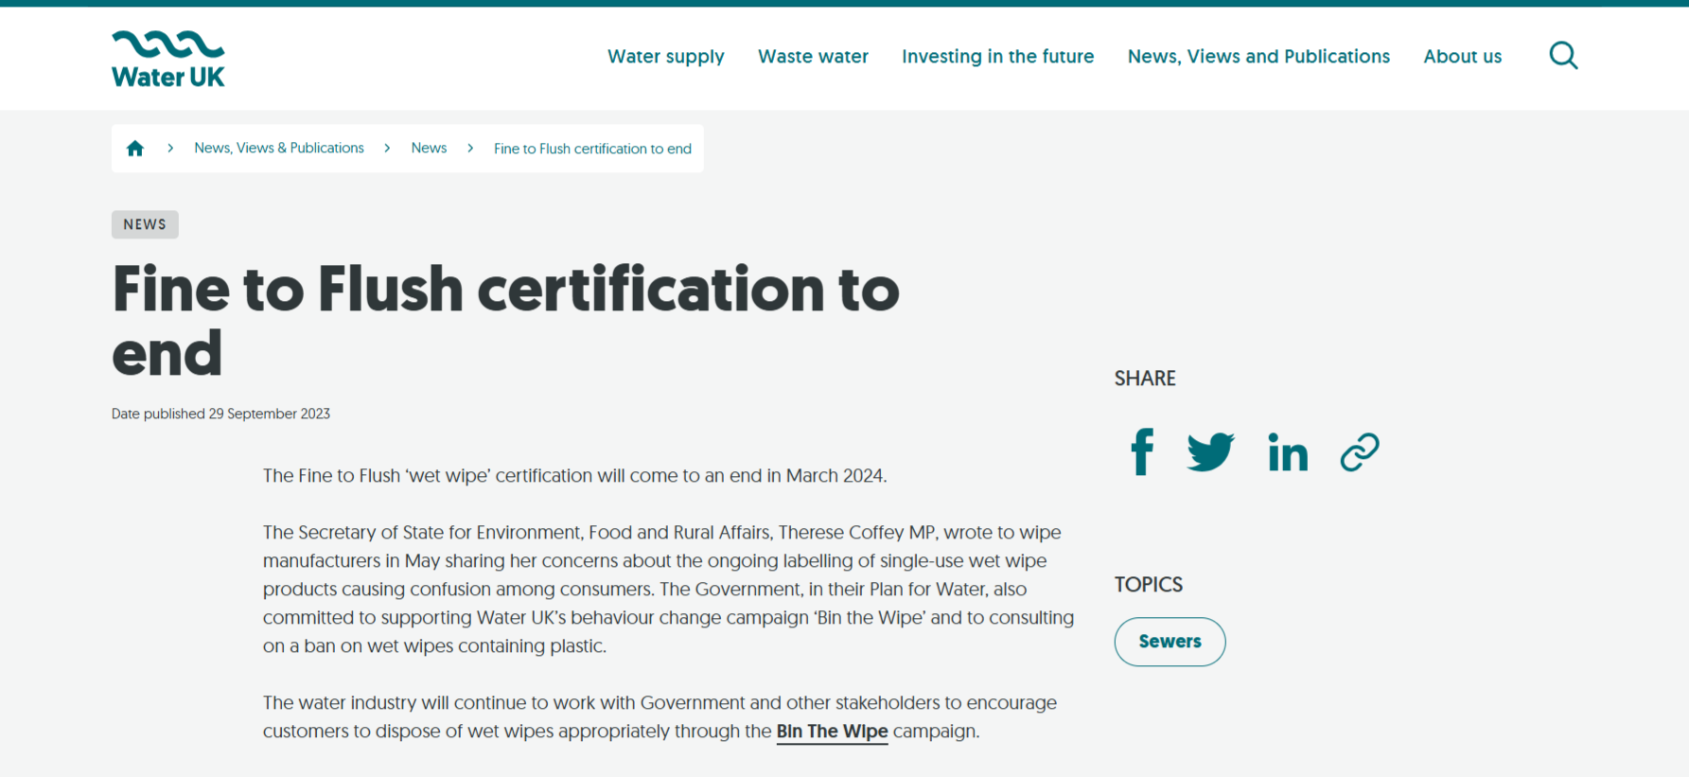



UK policy has moved from improving flushability to keeping wipes out of sewers altogether (only Pee, Poo and Paper is flushable).
https://www.water.org.uk/news-views-publications/news/fine-flush-certification-end
withdrawn

Slide 16
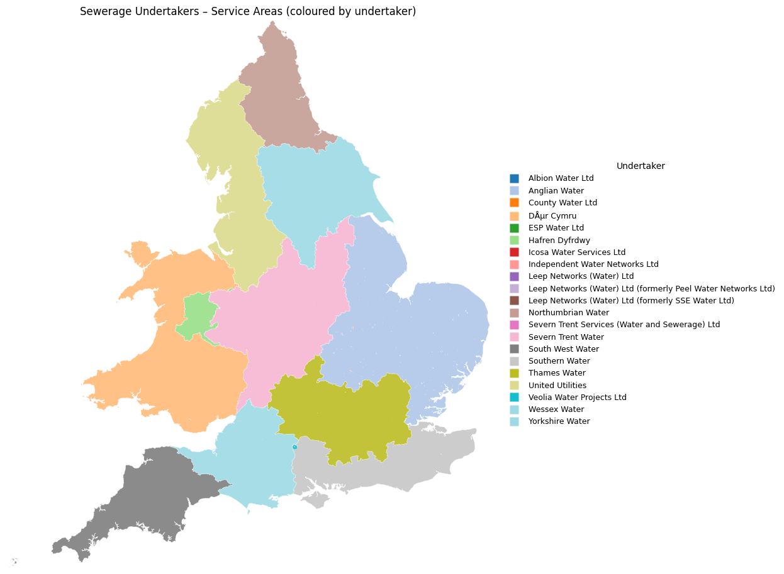
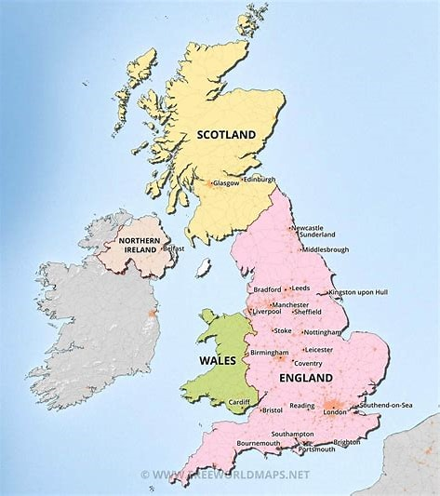
UK Sewerage Undertakers
Scotland & Northern Ireland are Government run Sewerage Undertakers . Wales has a “Not for Profit Organisation”. England- All English Sewerage Undertakers are profit seeking Businesses !

Slide 17
Core duties of Sewerage undertakers
A sewerage undertaker has a duty to provide, improve and extend the public sewer system either in or outside its area and to cleanse and maintain it so that its area is, and continues to be, effectually drained.
An undertaker must also make provisions for the emptying of its sewers and any lateral drains which belong to, or are vested in it, and for dealing with their contents, including trade effluent.
Each sewerage undertaker must prepare, publish and maintain a drainage and wastewater management plan (DWMP). The plan is a long-term plan for managing and developing the undertaker's drainage system and sewerage system so that it is able to meet, and continue to meet, its obligations under WIA,s.94 and associated duties including those arising under the Urban Waste Water Treatment (England and Wales) Regulations 1994.

Slide 18
Google Alert terms.
1. UK Water companies pollution incidents
2. Water UK /Wet wipes
3. Wet wipes Environmental concerns
4. Flushing wet wipes.
Tip: Set up a separate G-mail account- You can get a lot of Alerts.

Slide 20
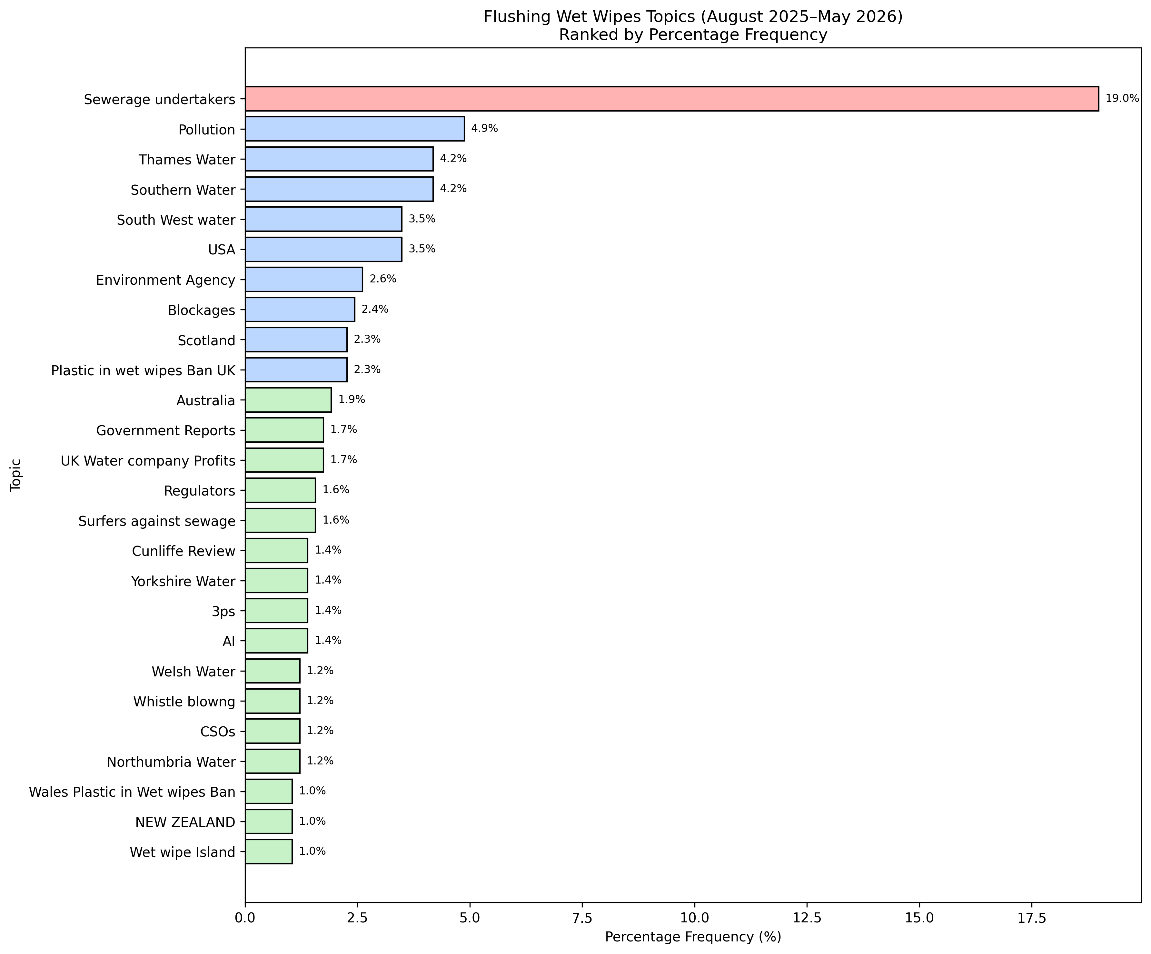




Slide 21
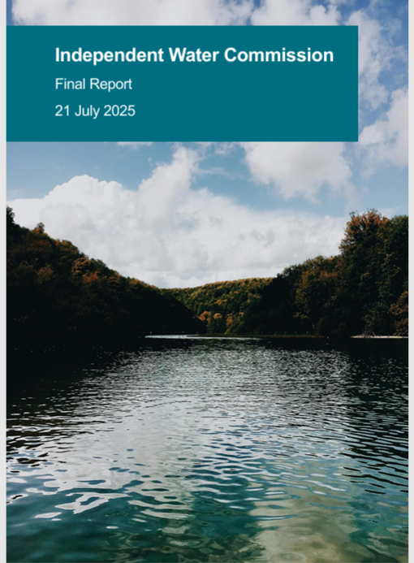
Independent Water Commission
(Cunliffe Review)
Key Findings – Final Report
(21 July 2025)
https://www.gov.uk/government/publications/independent-water-commission-review-of-the-water-sector

Slide 22





Key Findings of the Independent Water Commission. 88 recommendations
1. Fragmented Responsibilities:
- Multiple organisations manage drainage and wastewater, causing inefficiency.
2. Aging and Inadequate Infrastructure:
- Existing systems are outdated and vulnerable to overload.
3. Storm Overflows and Pollution:
- Over 100,000 overflow incidents in 2023 raised public concern.
4. Poor Public Confidence:
- Distrust in governance, regulation, and corporate performance.
5. Climate Change and Urbanisation:
- Growing environmental pressures worsen system stress.
6. Missed Opportunities for Nature-Based Solutions:
- SuDS and green infrastructure underused despite benefits.

Slide 23
IWC specifically on Wet wipes
Special Focus: Wet Wipes
The Commission specifically addressed the environmental impact of wet wipes as part of its work on wastewater, drainage, and pollution reduction.
Key Points:
Wet wipes, many of which contain plastics, are a significant cause of sewer blockages, contribute to “fatbergs,” and release microplastics into waterways.
They enter sewers either through incorrect disposal (flushing) or as litter that washes into drains and watercourses.
The Commission cited evidence from water companies, environmental groups, and local authorities showing that wet wipes are among the most common single-use items found in river and coastal clean-ups.
Recommendations on Wet Wipes:
Bans on Plastics in Wet Wipes – Endorse proposed UK-wide legislation to ban the sale of wet wipes containing plastic fibres.
Public Education Campaigns – Run sustained campaigns, coordinated with water companies, to change disposal behaviour and reduce sewer blockages.
Monitoring & Enforcement – Require water companies and local authorities to track wet wipe-related blockages and environmental pollution, reporting annually to regulators.

Slide 24

Direct Excerpts from IWC final report-
“Pre-Pipe solutions”
Recommendation 10:pp 447.
Government should consider legislative changes to drive a more coherent approach to ‘pre-pipe’ solutions to stop pollutants and rainwater entering the system.
Delivery via a Bill and Primary legislation.
Paragraph: 217. pp.112 of the main commission report.
“Both UK and Welsh governments should explore further measures to support CONSUMER BEHAVIOUR CHANGE, particularly for wet wipes. The UK Government should legislate swiftly, in line with its commitment, to ban wet wipes containing plastic. The UK government committed to legally banning wet wipes containing plastic and should legislate swiftly to this end; in Wales legislation to ban plastic wet wipes has already been passed by the Senedd.(Nation Cymru,2025) Given the environmental impact of all wet wipes (not just plastic) and other ‘unflushables’, further work is needed, including on behaviour change campaigns with support from government, the water industry, eNGOs and other relevant bodies.(Briain O et al.(2020)). The Commission notes that some targeted campaigns have already proven effective, such as the initial roll-out of the ‘Bin the Wipe’ campaign by Northumbrian Water, estimated to reduce blockages by 52% in targeted areas its first 3 years.(Northumbrian Water(2023))
Recommendation 85 pp.463
Water companies should work with Water UK to disseminate innovation learnings across the water industry in England and Wales.
Delivery via : industry led initiative.
Recommendation 88:
An independent review of the follow up to the Commission’s report should be carried out in 2 years’ time.
Delivery via: Government review on implementation

Slide 25
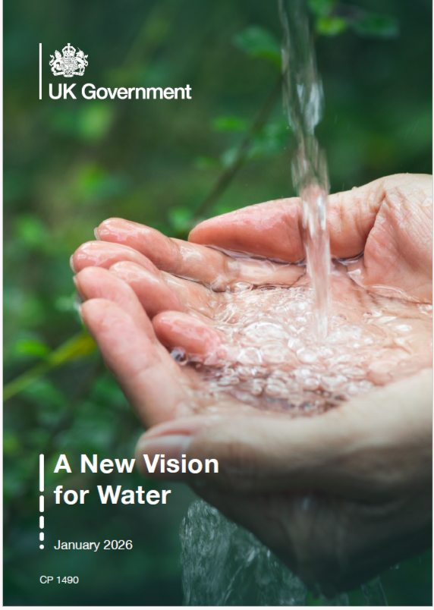
UK GOVT Water White paper
January 2026 UK (A blueprint for future water reform legislation)
We want to do better at addressing the root causes of pollution head-on. Therefore, we are proposing a shift in focus towards ‘pre-pipe’ solutions,
To enable this shift, we will ensure legislation, funding streams, and regulatory mechanisms support the delivery of pre-pipe solutions
We will also take stronger action to make sure the public are not inadvertently contributing to this pollution. We will do this by tackling sewer misuse to prevent sewer blockages, which will help maximise sewerage capacity, reduce pollution incidents, and sewer flooding.
We have already introduced legislation to ban wet wipes containing plastic, which will reduce plastic and microplastic pollution in our waters.
https://www.gov.uk/government/publications/a-new-vision-for-water-white-paper

Slide 26
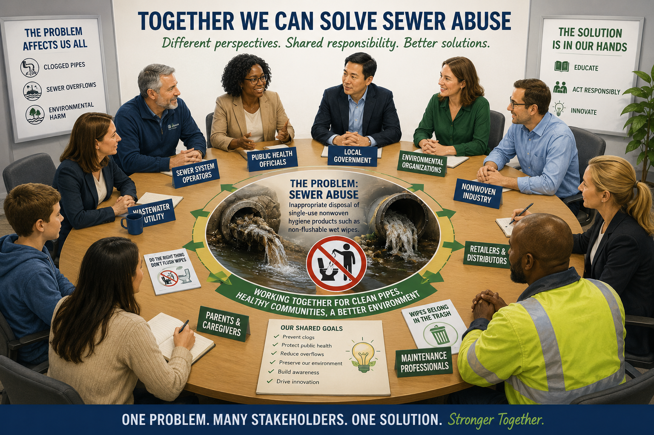

You are doing some great work here in the USA- other Geographical regions would benefit from a similar approach-RFA

Slide 27
“Sewer Misuse Discussion Forum”.
The discussion forum is an informal space in which to discuss the joint aim of reducing harm to the wastewater system and environment from sewer misuse and sewer blockages. convened by DEFRA.
Stakeholders include amongst others: The Sewerage Undertakers, Water company trade body , certain wet wipe manufacturers, certain wet wipe Brands, Consumer organisations for the water industry, Environmental NGO’s .
Opportunity for the Nonwovens industry to convey a message- e.g.An ISO Technical Specification has been approved. An Internationally agreed DNF label has been developed. Some European stakeholders are moving beyond a narrow ‘contains plastic / does not contain plastic’ distinction and increasingly regulating wipes based on sewer-system impacts and disposal behaviour. (SPAIN).
I may be involved from July 2026 (TBC).
Chatham House rules will apply .

Slide 28

What is the extent of the problem?
Lateral drain & Sewer Blockages.
My request(s) under The Environmental Information Regulations to the individual named sewerage undertakers in the United Kingdom:
Do you have data available that you can share that shows over the time periods 01/01/2025 to 31/12/2025 01/01/2024 to 31/12/2024 01/01/2023 to 31/12/2023 (a)The frequency of lateral drain blockages and of (b) sewer blockages and of ©pumping station clogs in the catchment area for your undertaking?
Are there suggested causation(s) provided for the lateral drain blockages, Sewer blockages and pumping station clogs. E.g. roots, FOG, Unflushables etc.
How many pumping stations are in your undertaking's catchment area? How many pumps are present at the pumping stations within the Undertakings catchment area?
I am researching sewer abuse and causation of inappropriate disposal.
EIR/ FOI REQUESTS

Slide 29
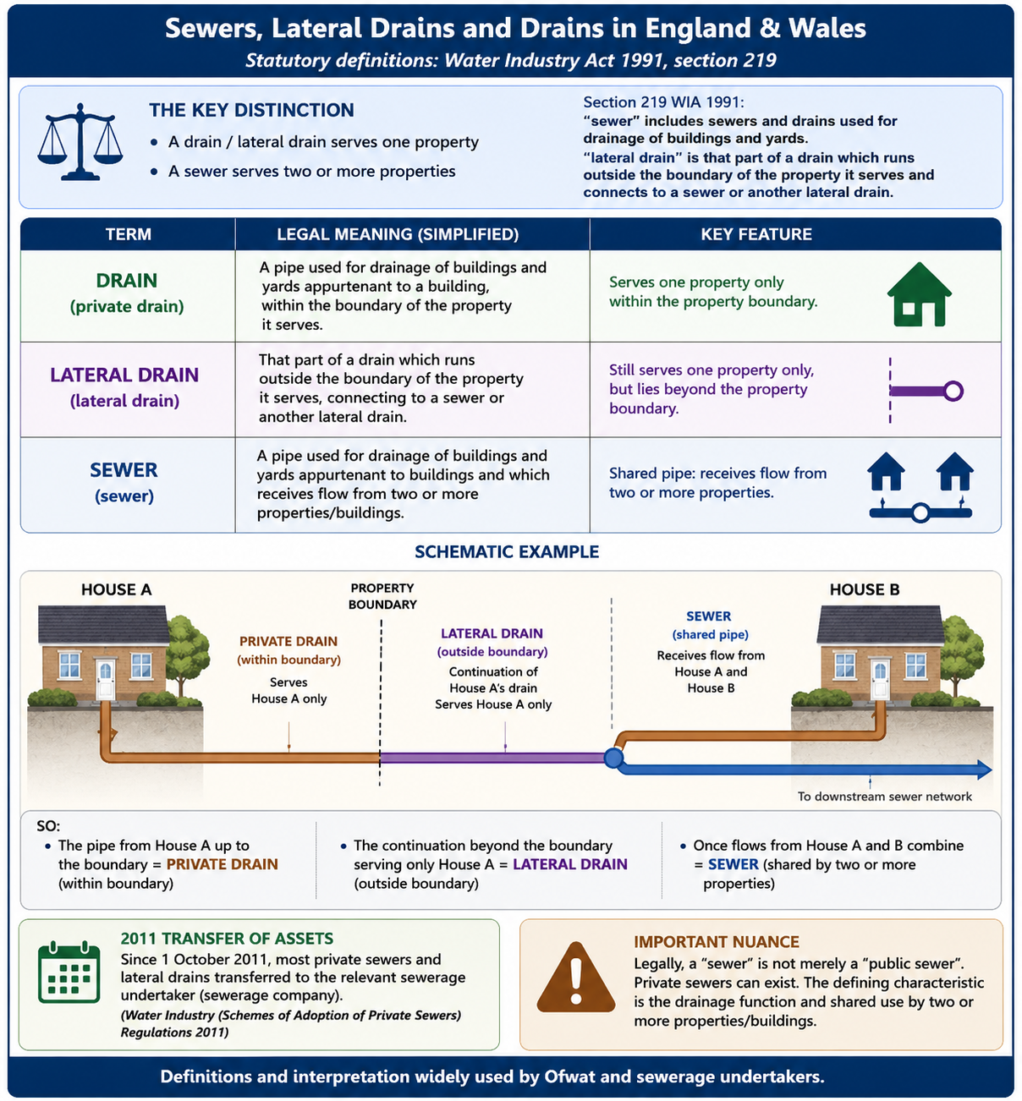

Slide 30

The Total number of blockages over financial years 23,24,25 and 26ytd(Feb) from one of the nine English Sewerage undertakers
(Identity anonymised) – call it company “X”.

Slide 31





The Top “causes” of Sewer blockage over financial years 23,24,25 and 26ytd(Feb) from one of the nine English Sewerage undertakers
(Identity anonymised) –call it company “X”
Numbers before descriptor are “blockage codes” specific to this undertaker

Slide 32





The Top “causes” of Lateral drain blockage over financial years 23,24,25 and 26ytd(Feb) from one of the 9 English Sewerage undertakers
(Identity anonymised) –call it company “X”
Numbers before descriptor are blockage codes specific to this undertaker

Slide 33



The Top “causes” of drain blockage over financial years 23,24,25 and 26ytd(Feb) from one of the nine English Sewerage undertakers
(Identity anonymised) –call it company “X”

Slide 34
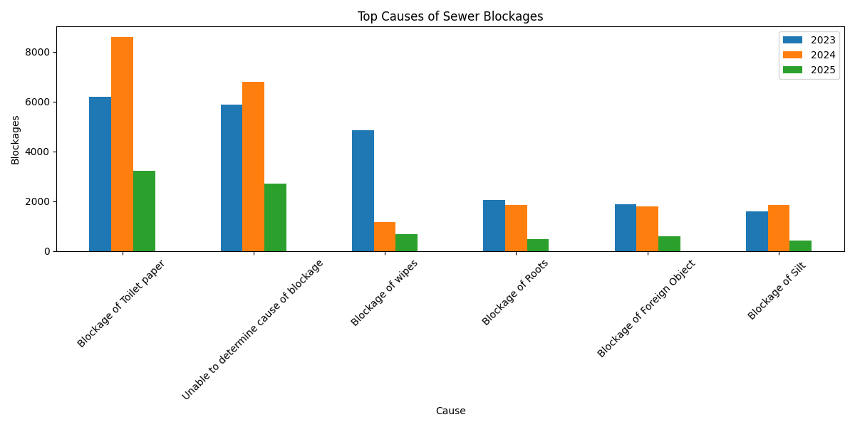



The Top “causes” of Sewer blockage over financial years 23,24,25 from one of the nine English Sewerage undertakers (Identity anonymised) –call it company “Y”

Slide 35
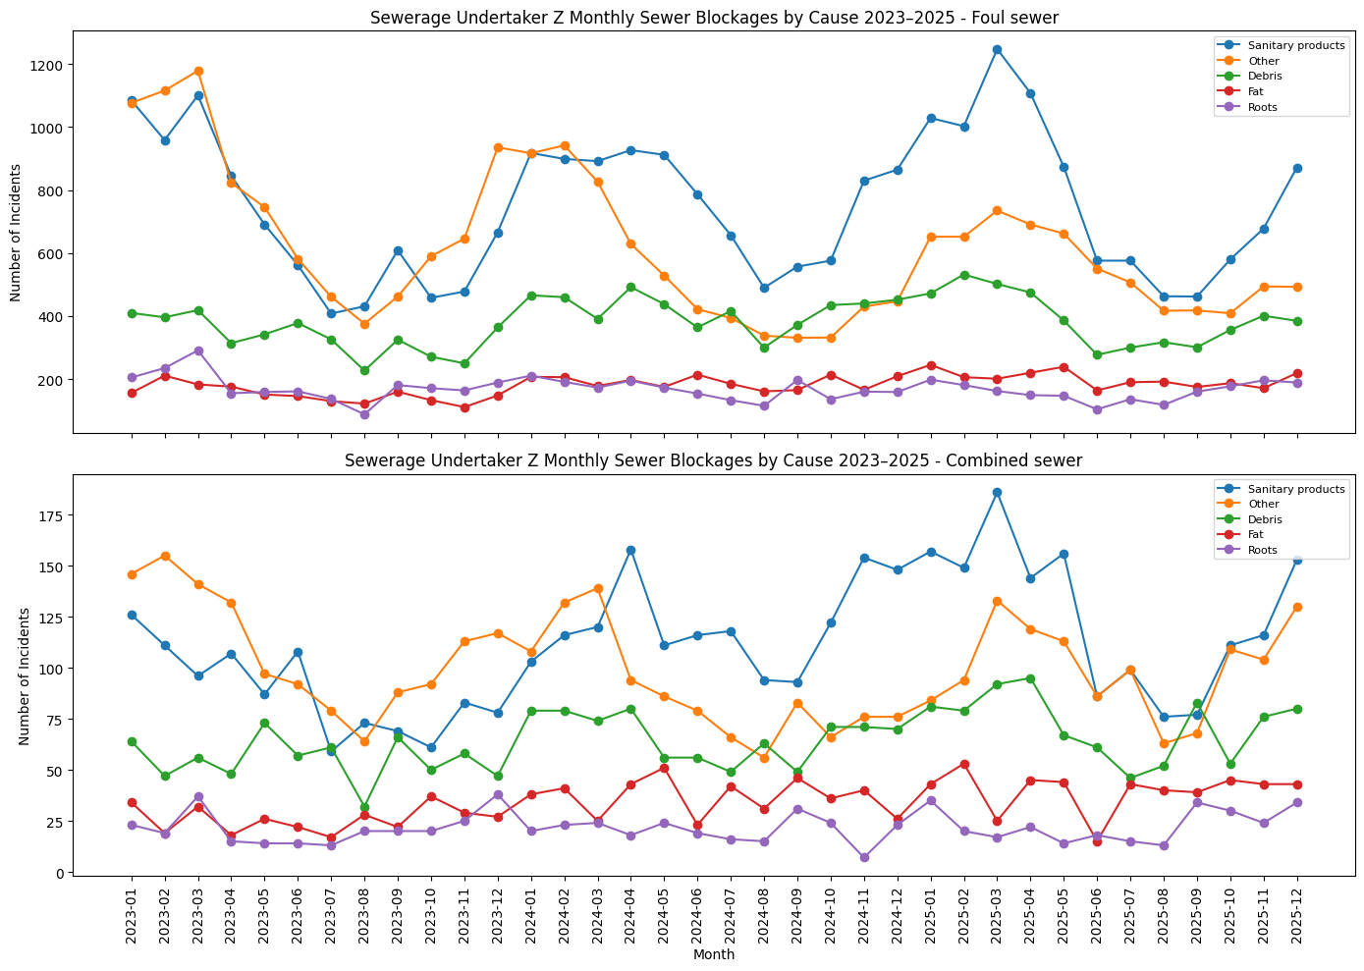


Monthly Sewer blockage by cause over years 23,24,25 from one of the 9 English Sewerage undertakers (Identity anonymised) –call it company “Z”

Slide 36

The last formal f2f meeting of ISO TC 224 WG10 occurred in June 2025.
After a long delay due to waiting on approval of a New Draft Do Not Flush logo by another ISO Technical committee TC145
A Final Draft Technical Specification ISO DTS 18671 2026 “Test methodologies for assessing
the compatibility of wet wipes and moist toilet tissue with the wastewater collection and
treatment systems, and appropriate labelling” was put out for approval of Technical content on 31 March 2026.
Voting closed on 25th May 2026.
Result: The Technical Specification was APPROVED and should be published.
Number of P member votes cast- 21 votes in favour out of 24 votes cast (88% , requirement > 66%). 17 abstentions
Member bodies voting: 3 negative votes out of 24 = 12 % (requirement <= 25%).
Last Virtual call held: 24th June 2026. Discussed comments to the Draft Technical Specification and proposed next steps.
9 countries made comments.
Update on the ISO Process

Slide 37
International Standard(IS)/ Technical Specification(TS)/Technical report (TR) “DELIVERABLES”
International Standards
An International Standard provides rules, guidelines or characteristics for activities or for their results, aimed at achieving the optimum degree of order in a given context. It can take many forms. Apart from product standards, other examples include: test methods, codes of practice, guideline standards and management systems standards.
Technical Specification
A Technical Specification addresses work still under technical development, or where it is believed that there will be a future, but not immediate, possibility of agreement on an International Standard. A Technical Specification is published for immediate use, but it also provides a means to obtain feedback. The aim is that it will eventually be transformed and republished as an International Standard.
Technical Report
A Technical Report contains information of a different kind from that of the previous two publications. It may include data obtained from a survey, for example, or from an informative report, or information of the perceived “state of the art”.
Source: https://www.iso.org/deliverables-all.html (Accessed June ,2026)

Slide 38

VOTED TO DISAPPROVE THE DTS !
(collective responsibility/ CONSENSUS of delegation is not necessarily unanimity )
In essence only 3p’s are flushable. “Bin the wipe”
GB Reasoning:
General:The nature of the document runs contrary to central government guidance (via DEFRA) and that of the UK’s primary trade organisation (Water UK) representing the UK’s water and sewerage companies.
Water UK has agreed to and is in the process of withdrawing ‘WIS 4-02-06 Issue 1.2 November 2019 Fine to Flush: Specification for a testing methodology to determine whether a product is suitable for disposal through a drain or sewer system’.
Technical: Proposed change: Withdraw ‘WIS 4-02-06 Issue 1.2 November 2019 Fine to Flush: Specification for a testing methodology to determine whether a product is suitable for disposal through a drain or sewer system’ from the bibliography and any reference to it throughout the DTS.
If accepted and actioned -Only GD4 based test methodologies would remain

Slide 39
The ISO Secretariat did not accept the GB Proposed Technical change: Withdraw ‘WIS 4-02-06 Issue 1.2 November 2019 Fine to Flush: Specification for a testing methodology to determine whether a product is suitable for disposal through a drain or sewer system’ from the bibliography and any reference to it throughout the DTS .
It suggested that such a late change in the document would not be accepted. It further suggested that the UK WIS 4-02-06 would be removed from either the next revision of the published Technical specification or that the UK WIS 4-02-06 would not be within scope of any future NWIP looking to develop a uniform single standard .
It is likely that the TS will be published by/ during August 2026

Slide 40
The UK does not have a legally prescribed
Do Not Flush logo.
Harmonise on an internationally developed ISO approved logo ? ?
An Opportunity for the UK?
DO NOT FLUSH

Slide 41
Next Steps on the ISO Journey- Attempt a UNIFORM SINGLE STANDARD?
There was a majority agreement to progress to a uniform single standard entitled “Assessing the compatibility of wet wipes and moist toilet tissue with wastewater collection and treatment systems and appropriate labelling”.
A form 4 proposal document would be raised to be consistent with the structure of DTS 18671. The form would be submitted to ISO TC 224 secretariat by the end of September 2026.
This will be voted on: to be accepted, the vote requires: Approval by a 2/3 majority of the voting P-members; and A commitment to participate actively in the development of the project by at least 5 P-members in committees with 17or more P members that have approved the proposal and nominated an expert.

Slide 42
















Delegations to ISO TC 224 WG 10
Active participation is the best strategy! - and for sure if the process is ever resurrected.
Liaisons: INDA , EDANA, TC6.
EUR EAU is not a Liaison.
14 delegations are countries in which there are potential EurEau members
Argentina — IRAM | France — AFNOR | Norway — SN | Sweden — SIS
Australia — SA | India — BIS | Portugal — IPQ | Switzerland — SNV
Austria — ASI | Indonesia — BSN | Russian Federation — GOST R | Tunisia — INNORPI
Bolivia, Plurinational State of — IBNORCA | Ireland — NSAI | Saudi Arabia — SASO | Uganda — UNBS
Canada — SCC | Israel — SII | Senegal — ASN | United Arab Emirates — MoIAT-STR
China — SAC | Japan — JISC | Singapore — SSC | United Kingdom — BSI
Czech Republic — UNMZ | Kenya — KEBS | Slovakia — UNMS SR | United States — ANSI
Denmark — DS | Korea, Republic of — KATS | South Africa — SABS | Egypt — EOS
Finland — SFS | Morocco — IMANOR | Spain — UNE | Germany — DIN
Active participant in ISO TC224WG10, Secretariat, Delegations with nonwoven representation,
Consistent do not believe in flushables other than pee, poo and paper.

Slide 43

What should the wipes industry do next in relation to ISO?
Continued active participation in my view the best strategy.
It may be that laws are now in-force in certain geographical regions prescribing “covered products” with DNF labelling or that collection studies show minimal retention of “flushable” wiping materials (so why continue?). However:
Other geographical regions /markets are drafting country specific standards in relation to flushable products. Standards are proliferating.
With only 3 delegations having representatives from the nonwovens / wiping industry the process could continue without our input !
  The views expressed in this presentation are my own and do not reflect any organisation / body. I am not expressing any views on behalf of or reflective of the GB delegation to ISO TC224WG10.

Slide 44

How will the Wastewater industry want to proceed with the ISO process? (speculation)
Some delegations will want to continue.
Some delegations will aim to develop their own National standards(and maybe continue with ISO)
How can you overcome the mantra only pee, poo and paper is flushable-nothing else? Or How can you maintain > 66% of “P” member delegation votes
  The views expressed in this presentation are my own and do not reflect any organisation / body. I am not expressing any views on behalf of or reflective of the GB delegation to ISO TC224WG10.

Slide 45
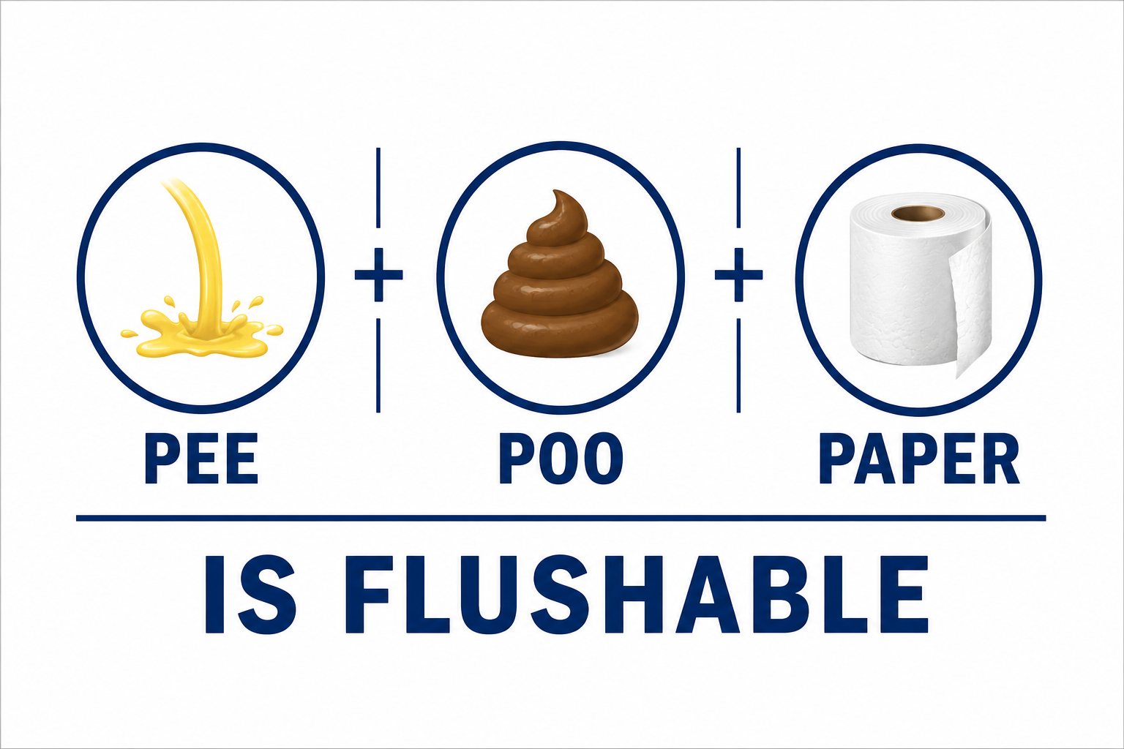

Interestingly the mantra of the 3ps was expounded by the UK. But surprisingly during this round not by other delegations where the country may have a EurEau Member organisations.
Exception = Sweden where it is illegal to flush anything other than Pee, poo and paper in the toilet
So, what is going on in Europe?

Slide 46

Directive 2019/904
Single Use Plastics Directive: Evaluation /possible revision.
(Stay close to European Trade Associations e.g. EDANA)
Must be EVALUATED by the EU Commission by 3rd July,2027 (Article 13 of Directive 2019/904)
Following the evaluation the commission may propose further measures including binding quantitative consumption reduction targets or other measures to strengthen the legislation.
The review is supposed to assess, among other things “Scientific and technical progress concerning criteria or a standard for biodegradability in the marine environment” applicable to single use plastic products.
The Directive sets up monitoring and reporting obligations ;member states must annually report on consumption, collection and implementation progress
This legal framework anticipates a review and a possible REVISION after 2027.
The commission could decide to amend , replace or supplement the Directive based on evidence and consultations.
Preparatory steps:
A Circular Economy Act – A consultation has been launched (August,2025)that may interplay with revisions to plastics and waste legislation more widely .
Any process to revise would follow normal EU legislative practice: the Commission would publish a proposal (or proposals), which would then go through the ordinary legislative procedure (i.e. co-decision by Parliament and Council) — unless a special procedure is used.
Prior to a formal proposal, the Commission generally launches public consultations, calls for evidence, surveys, impact assessments, and stakeholder hearings (this is standard practice for environmental and regulatory updates).
*** Formal evaluation and public consultation have occurred already via the “Have your say portal” see:
https://ec.europa.eu/info/law/better-regulation/have-your-say_en

Slide 47
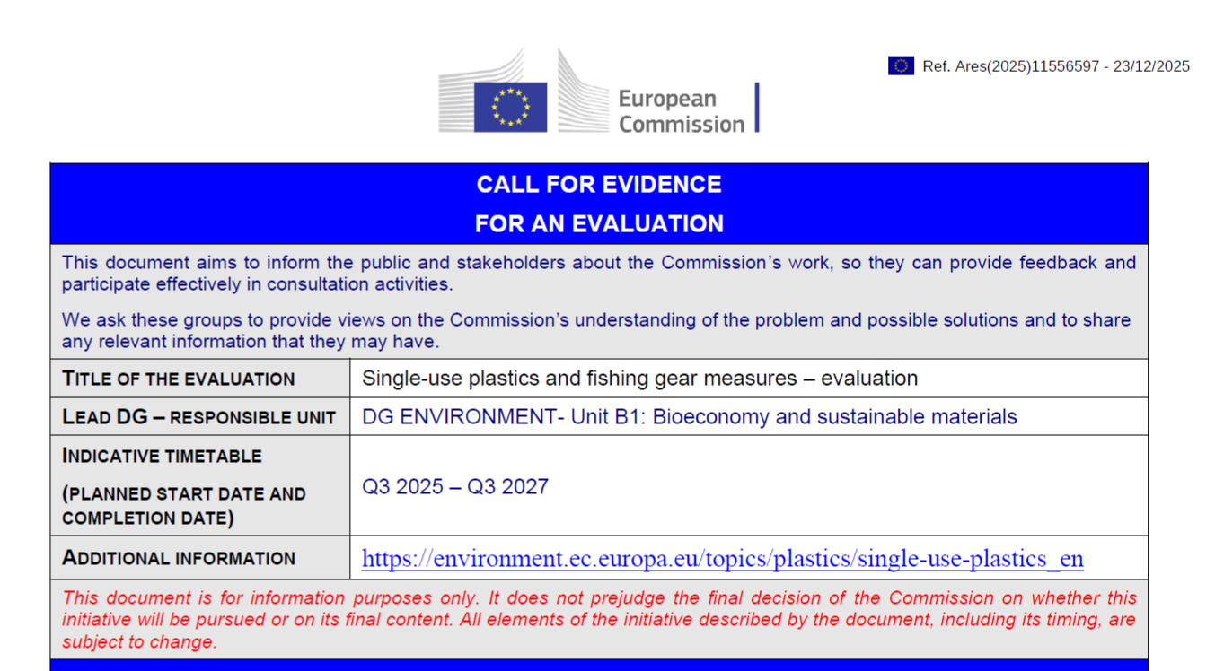
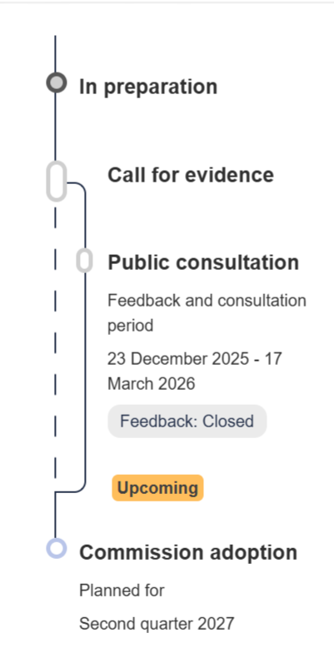




CALL FOR EVIDENCE FOR AN EVALUATION Single-use plastics and fishing gear measures – evaluation
579 items of feedback provided by respondents.
I am going to focus on feedback from one respondent EurEAU
https://ec.europa.eu/info/law/better-regulation/have-your-say/initiatives/14422-Rules-on-single-use-plastics-and-fishing-gear-evaluation_en

Slide 48



SUP Directive (EU) 2019/904
Call for Evidence – Purpose
Engage stakeholders & gather early feedback
Validate understanding of key problems & impacts
Collect evidence on costs, benefits & implementation
Assess performance (effectiveness, efficiency, relevance, coherence, EU value)
Inform future policy (review, simplification, new measures)
Capture stakeholder views on progress & challenges
Key takeaway: Ensures a robust, evidence-based evaluation to support future EU policy decisions
Source:https://ec.europa.eu/info/law/better-regulation/have-your-say/initiatives/14422-Rules-on-single-use-plastics-and-fishing-gear-evaluation_en
60

Slide 49


The Voice of Europe’s Water Sector:
Represents Europe’s drinking water and wastewater service providers
Umbrella association: 38 national associations across 32 countries. National associations of water and wastewater operators (not individual companies).
Covers utilities serving ~500 million people
Mission: Advocate for sustainable water services, influence EU policy, share collective expertise- utilities, municipalities, water boards
https://www.eureau.org
https://www.eureau.org/documents/diverse/8073-eureau-letter-to-iso-tc224-on-dis18671/file
Historically only PEE, POO and PAPER is FLUSHABLE-NOTHING ELSE

Slide 50

Unexpected statements
in the
EurEau response
Excerpts:
“Typical wet wipes are designed to be robust whether or not they contain plastics. Moist toilet tissue on the other hand is a different type of wipe, which is designed to behave like toilet paper and break up readily in the sewer”.
Definition of SUP: “The current SUP definition is not satisfactory. The exclusion of natural polymers does not reflect real impacts: plastic-containing wet wipes made from natural fibres may still cause sewer blockages. We need to go beyond biodegradability and include dispersibility in sewer systems and disintegration time. A regulation proposed by the Spanish government establishes strict pass/fail criteria to clearly identify those products that negatively affect the sewer system due to insufficient dispersibility”.
We will have a look at Spain in a minute
See https://ec.europa.eu/info/law/better-regulation/have-your-say/initiatives/14422-rules-on-single-use-plastics-and-fishing-gear-evaluation_en (click on “view feedback received” and search “EurEau” (page 44 of responses)

Slide 51
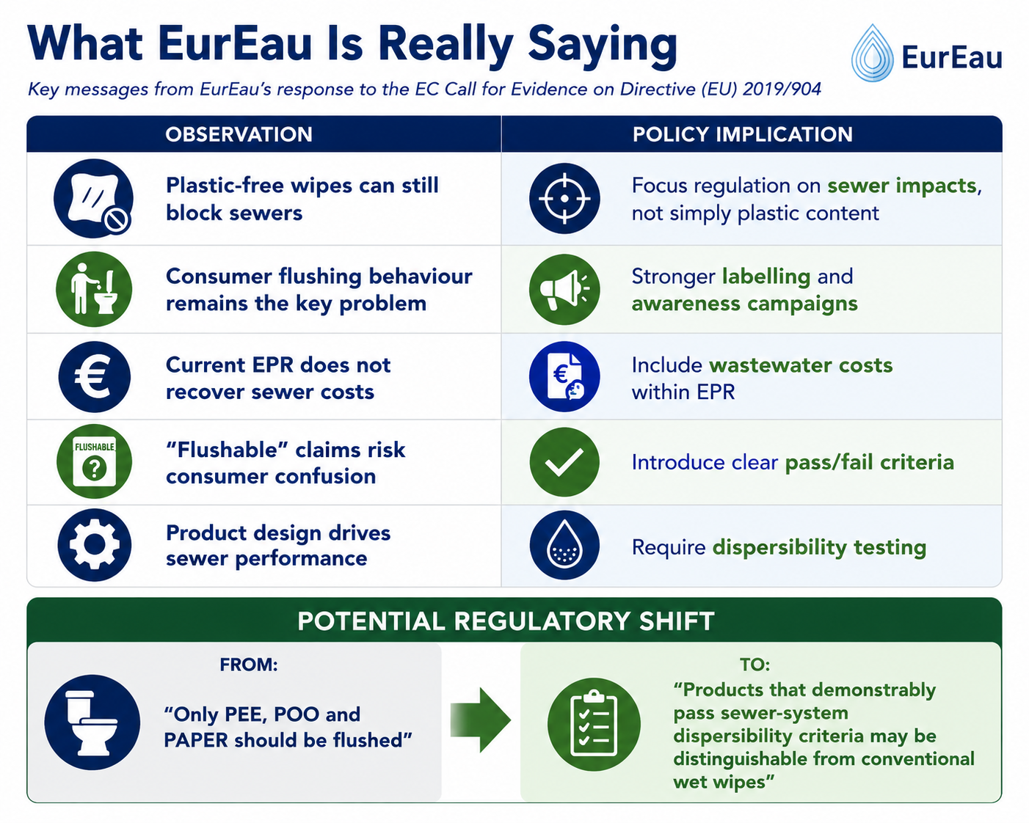




Slide 52




Take an interest !
Spain Draft Wet Wipes Decree –
Key Drivers and Article 8 Implications
Spain is moving beyond a narrow ‘contains plastic / does not contain plastic’ distinction and increasingly regulating wipes based on sewer-system impacts and disposal behaviour.
Theme | What the Draft Decree Says | Strategic / Industry Significance
Why the Decree Was Proposed | Addresses sewer blockages, pump failures, wastewater-treatment impacts, marine litter and clean-up costs associated with wet wipes and balloon releases. | Focus is on operational sewer impacts and environmental management costs rather than solely on plastic content.
Article 8 – Disposal Route | Wet wipes and balloons must enter the residual waste stream. Wet wipes must not be disposed of via toilets. | Spain is directly targeting consumer disposal behaviour (‘do not flush’) rather than relying only on product bans.
UNE 149002:2022 Exception | Wipes meeting the Spanish flushability standard UNE 149002:2022 are treated differently. Flushing is not prohibited in the same way, although avoidance of flushing is still recommended. | Leaves limited regulatory space for ‘flushable’ wipes, but signals continuing government caution even for technically compliant products.
Beyond Plastic-containing Wipes | Draft definitions extend beyond conventional plastics and can include viscose and lyocell-based wipes. | Potentially significant shift: sewer performance and dispersibility may become more important than whether a wipe contains plastic.
Comparison with UK Approach | Spain focuses on sewer-system impacts, disposal practices, EPR obligations and wastewater costs. | The UK has primarily focused on banning wet wipes containing plastic. Spain’s model could influence future EU regulatory direction.
Source: Draft Spanish Royal Decree on Wet Wipes and Balloons (Proyecto de Real Decreto) – MITECO, Spain.
https://www.miteco.gob.es/en/Calidad-y-evaluacion-ambiental/participacion-publica/proyecto-de-real-decreto-por-el-que-se-regula-la-gestion-de-los-.html

Slide 53
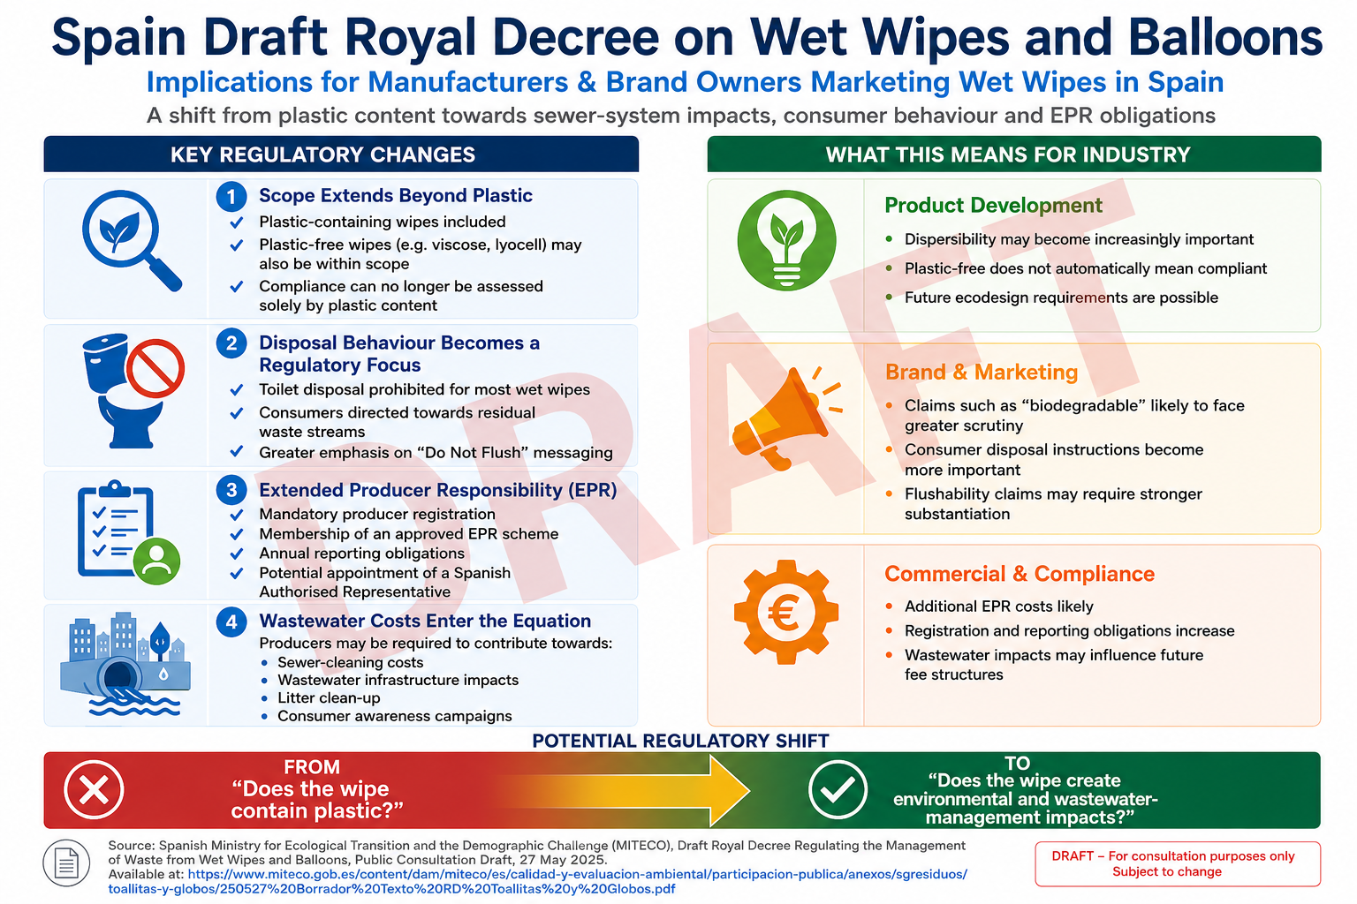


Slide 54
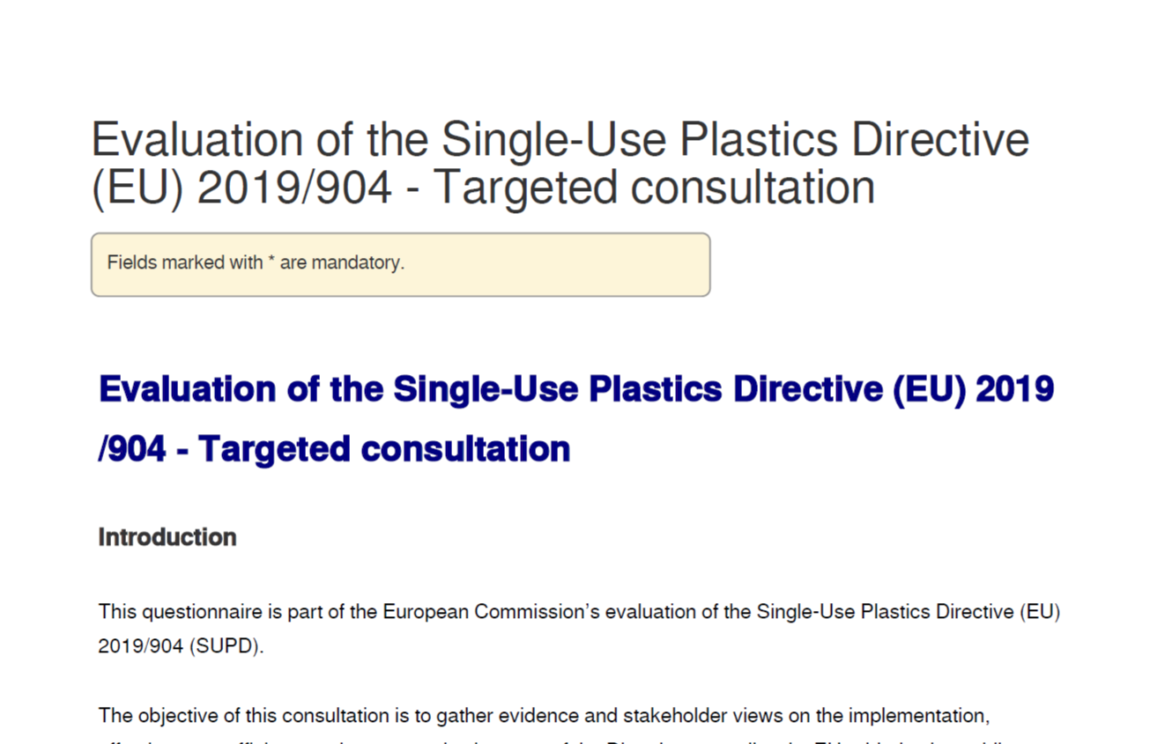

Evaluation of the Single-Use Plastics Directive (EU) 2019 /904 - Targeted consultation
https://ec.Europa.eu/eusurvey/runner/806dd425-4243-f303-1888-40e63a75dfcd
Web page vaporised June 2026 (no longer available)
107 questions (a,b,c etc ) 48 pages, Consultation closed on May 8,2026

Slide 55




EU SUPD Targeted Consultation Key Summary
WHY?
Evaluate effectiveness & EU added value
Assess implementation & enforcement
Identify gaps & simplification needs
Review scope & definitions
Inform future policy / targets
KEY QUESTIONS
Impacts: environmental, health, behaviour
Scope gaps & exemptions
Costs, SMEs & market impacts
Implementation & admin burden
Definitions & measurement methods
POLICY FOCUS
Bans, reduction, EPR, labelling, collection
Feasibility of EU-wide targets
Coherence with EU & global policy
Innovation & alternatives
EVIDENCE
Data-driven responses required
Quantitative evidence + case studies
  Consultation was available at: https://ec.Europa.eu/eusurvey/runner/806dd425-4243-f303-1888-40e63a75dfcd#
  Consultation closed on May 8,2026.

Slide 56





Stakeholder Category | Description / Examples
Waste Collection & Treatment | Organisations responsible for collecting, sorting, recycling or treating waste, including municipal services, private waste operators, and wastewater treatment facilities.
Producers / Brands | Organisations that manufacture, import, or place SUPD-covered products on the market, including product manufacturers and brand owners.
Producer Responsibility Organisations (EPR Schemes) | Organisations managing Extended Producer Responsibility (EPR) obligations for products covered by the SUPD.
Retail & Distributors | Organisations selling or distributing products to consumers or businesses, such as supermarkets, wholesalers, online sellers, marketplaces, and food-delivery platforms.
Professional End Users | Organisations using SUPD-covered products in their operations but not manufacturing or selling them, e.g. fisheries, aquaculture, hospitality, healthcare, cleaning services, and port operators.
Non-Governmental Organisations (NGOs) | Civil society organisations working on environmental protection, circular economy, marine litter, waste management, or related sustainability issues.
Consumer Associations | Organisations representing consumer interests, including consumer rights, safety, environmental concerns, and product-information transparency.
Research & Academia | Universities, research institutes, consultancies, and scientific experts working on plastics, materials science, waste management, marine litter, or related research fields.
International Organisations & Scientific Bodies | Regional or international organisations involved in environmental governance, monitoring, or scientific cooperation, e.g. OSPAR Commission, HELCOM, Barcelona Convention, Black Sea Commission, and UNEP-MAP.
Other (please specify) | Any stakeholder group not covered above but with an interest or involvement in the implementation or evaluation of the Single-Use Plastics Directive (SUPD).

Slide 57
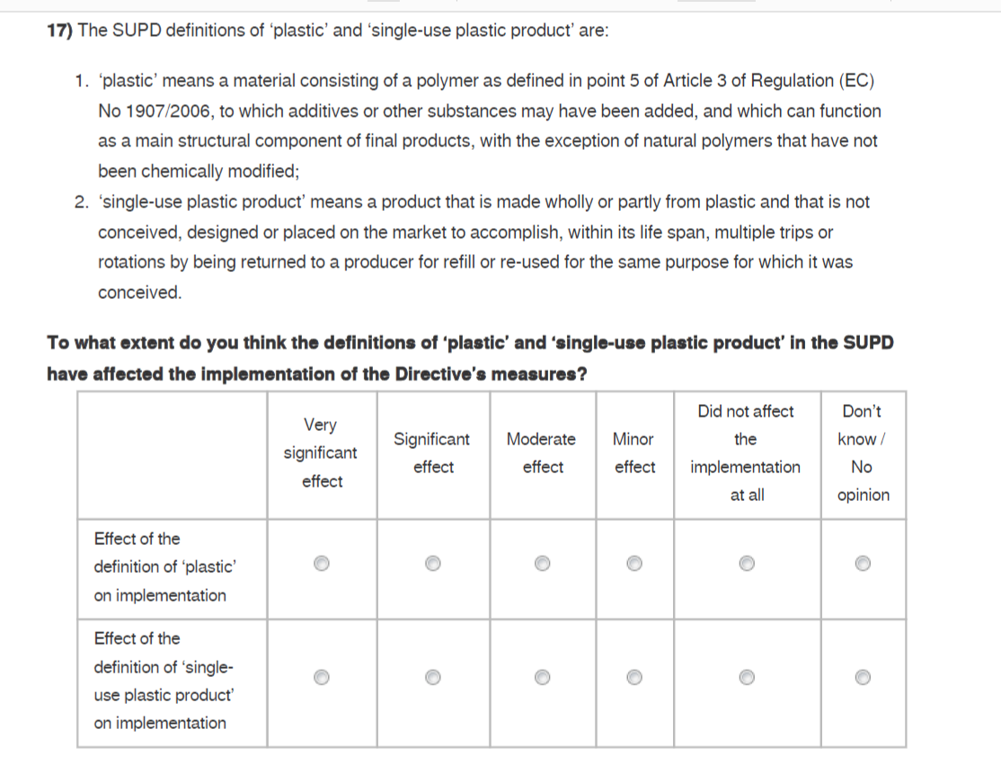

Similar in GB

Slide 58
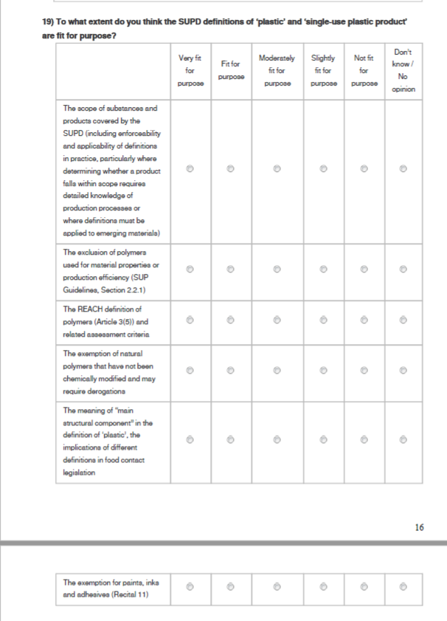


To what extent do you think the SUPD definition of plastic is fit for purpose ?
The exemption of natural polymers that have not been chemically modified and may require derogations
Cf. USA definition of “covered product” that puts focus on petrochemical-derived fibers
The exemption for paint, inks and adhesives (Recital 11)

Slide 59


Portugal: Wet Wipes – Policy & Market Developments
Policy Drivers (SUP context)
  NGO(Quercus) campaign for ban on non‑biodegradable wipes
  Sewer blockages & marine litter impacts
  Call for national awareness measures (Art.10‑type)
  EPR cost recovery for wastewater costs
Implications for Industry
  Product redesign to meet "genuine biodegradability"
  Potential EPR fees linked to wastewater
  Mandatory labelling & consumer communication
  Need for proactive transition planning
“It is necessary to raise public awareness about this problem and promote more responsible behaviour,” says Quercus which will have been buoyed in this endeavour by practices in other countries – specifically the UK, where non-biodegradable wet wipes are being banned from next year. See: https://www.portugalresident.com/ngo-wants-ban-on-non-biodegradable-wet-wipes/

Slide 60
Why the Netherlands Did Not Ban Wet Wipes
(Feb 2025)
Proposal: National ban on plastic-containing wet wipes to reduce sewer blockages and plastic pollution
Decision: A narrow majority (73 to 72 votes !) in the Dutch parliament blocked the proposed ban
Reasons: Considered disproportionate and going beyond existing EU requirements; focus should be on disposal behaviour
Outcome: No national ban adopted; government shifted focus to EU-level regulation
https://nos.nl/artikel/2555336-kabinet-wil-verbod-op-plastic-in-vochtige-doekjes-regelen-in-europa

Slide 61
Republic of Ireland:
Wet Wipes Regulation – Signals vs Reality
Market & Media Signals:
• Irish media and policy commentary (2023–2025) has suggested Ireland *may* follow the UK’s lead in banning plastic-containing wet wipes.
• Commentary largely driven by UK action, marine litter concerns, and sewer blockage impacts.
What Ireland Is Actually Doing Now:
• No announced or legislated ban on the sale of plastic-containing wet wipes.
• Wet wipes containing plastic are included in Extended Producer Responsibility (EPR) schemes.
• Producers contribute to litter clean-up costs and comply with EU Single-Use Plastics labelling requirements.
Context for Suppliers:
• Regulatory pressure exists, but Ireland remains aligned with EU framework rather than UK-style bans.
• UK bans (England, Wales, Scotland) remain the primary immediate market driver for fibre substitution.
https://www.independent.ie/irish-news/will-ireland-follow-uks-lead-and-ban-plastic-containing-wet-wipes/a50661859.html

Slide 62
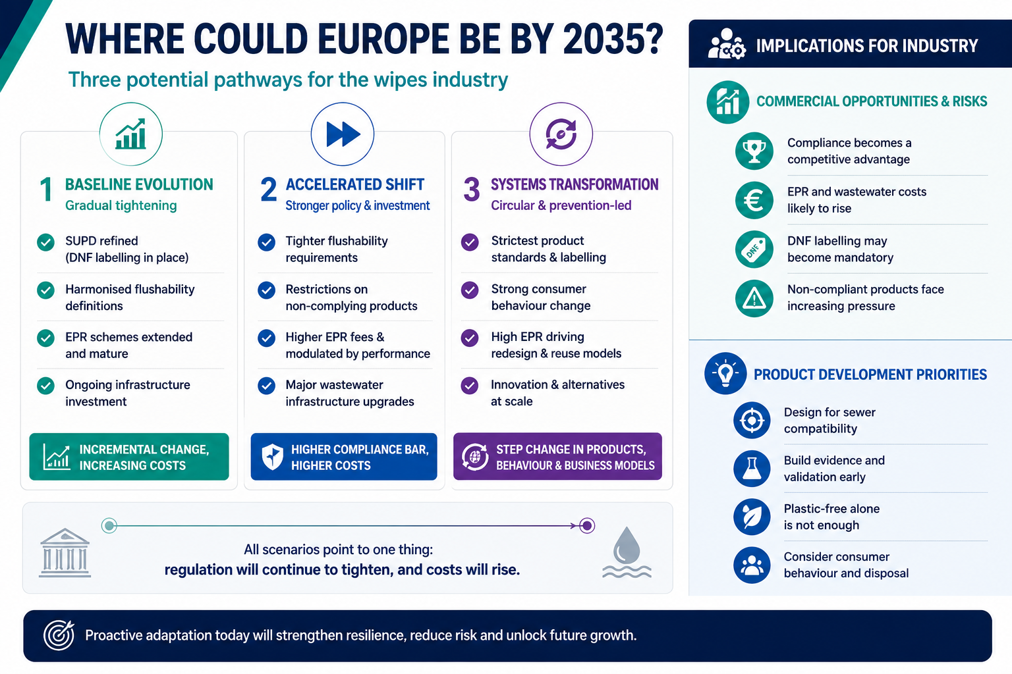







Slide 63
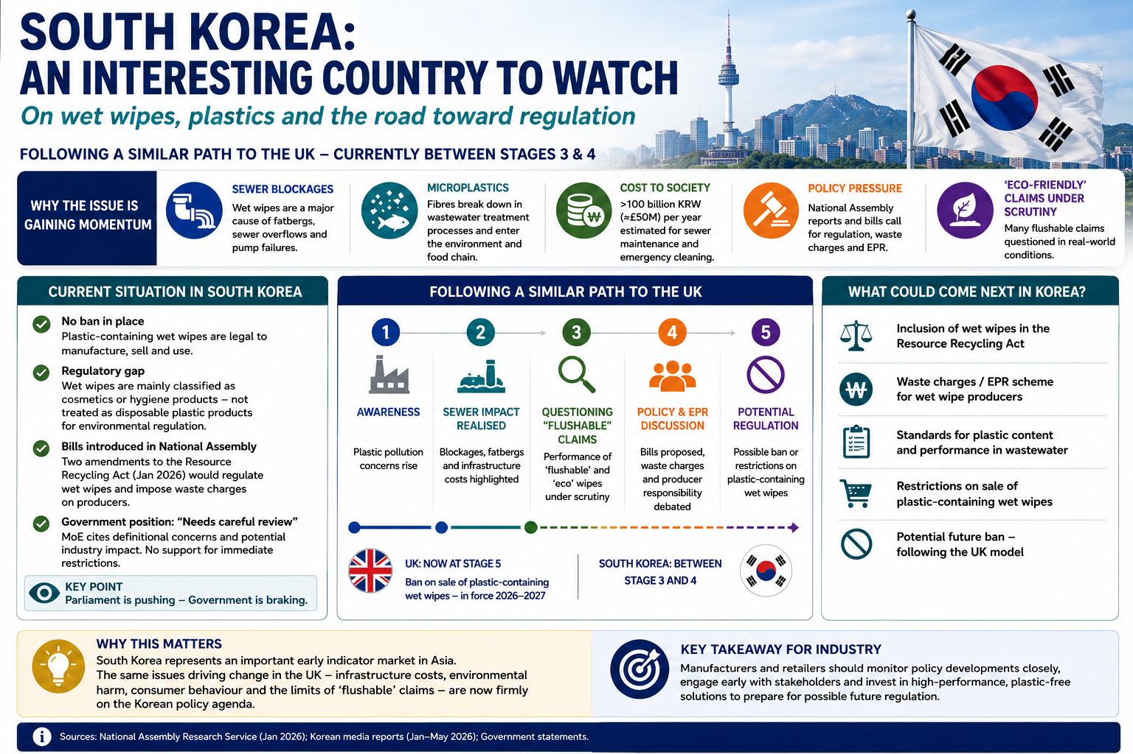



Slide 64
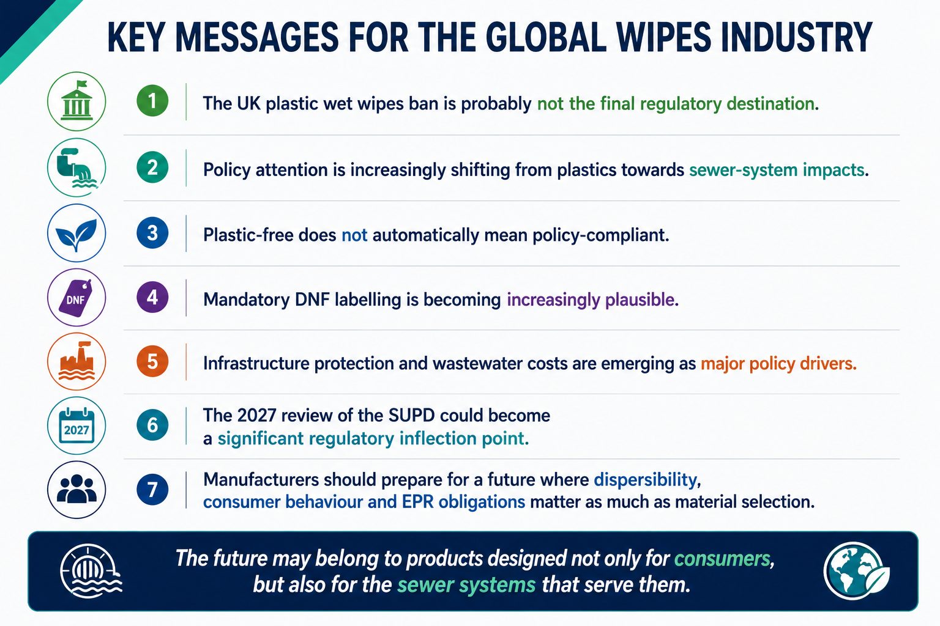


Slide 65

THANK YOU !
Any Questions?
David E. James
LLM, PgDip, ScsDip, MIMMM, APkgPrf, Ctext, FTI
📱 +44 7881 940067
✉️ David@davidejamesconsulting.co.uk
🌐 https://davidejamesconsulting.co.uk
💼 Enquiries@davidejamesconsulting.co.uk
📅 https://calendly.com/david-davidejamesconsulting/new-meeting-2
📅 https://calendly.com/david-davidejamesconsulting/new-meeting

Slide 66


Slide 67
References
EurEau(2025).EurEau raises concerns about ISO/DIS 18671 Standard. Available from: https://eureau.org/news/eureau-raises-concerns-about-iso-dis-18671-standard (Accessed: June,2026).
EurEau(2026). About us. Available from: https://eureau.org/about/about-us/ (Accessed: June,2026).
European Commission(2025).Rules on Single-Use plastic and fishing gear (Evaluation). Call for evidence for an evaluation- Ares(2025) 11556597. Available from: https://ec.europa.eu/info/law/better-regulation/have-your-say/initiatives/14422-Rules-on-single-use-plastics-and-fishing-gear-evaluation_en (Accessed: June,2026).
European Commission(2026).Have your say-public consultations and feedback. Available from: https://ec.europa.eu/info/law/better-regulation/have-your-say_en (Accessed: June,2026)
European Commission(2026). Evaluation of the Single-use Plastics Directive (EU) 2019/904 – Targeted Consultation. Available from: https://ec.Europa.eu/eusurvey/runner/806dd425-4243-f303-1888-40e63a75dfcd (Link vaporised June,2026).
Farell, S.(2022).Aldi switches all own label wipes to plastic free and biodegradable materials. The Grocer. March. Available from: https://www.thegrocer.co.uk/news/aldi-switches-all-own-label-wipes-to-plastic-free-and-biodegradable-materials/665308.article (Accessed: June,2026).
Gi-Ung, B.(2026). The betrayal of “ecofriendly” wet wipes that consumers were told to flush down the toilet…more that 100 billion won a year just for sewer maintenance. Available from: https://www.khan.co.kr/en/article/202601121725157

Slide 68
References
Gobierno De Espana(2025). Draft , Draft Royal decree regulating the management of wet wipes and balloon waste. Available from: https://www.miteco.gob.es/en/Calidad-y-evaluacion-ambiental/participacion-publica/proyecto-de-real-decreto-por-el-que-se-regula-la-gestion-de-los-.html (Accessed: June,2026)
Gov.uk(2025). Guidance. Plastic wet wipes ban. Available from: https://www.gov.uk/guidance/plastic-wet-wipes-ban (Accessed: June,2026).
Gov.uk(2025). Independent Report. Independent Water Commission: review of the water sector. Available from: https://www.gov.uk/government/publications/independent-water-commission-review-of-the-water-sector (Accessed: June,2026).
Gov.uk(2026) Policy Paper. A new vision for water: White paper. Available from: https://www.gov.uk/government/publications/a-new-vision-for-water-white-paper (Accessed: June,2026).
Gov.Wales(2020).Reducing single use plastics. Proposals to ban nine single use plastic products in Wales. Welsh Government. WG-40193,pp.24. Available from: https://www.gov.wales/sites/default/files/consultations/2020-07/reducing-single-use-plastics-consultation.pdf (Accessed: June,2026)
Irish Independent(2025). Will Ireland follow UK’s lead and ban plastic-containing wet wipes. Available from: https://www.independent.ie/irish-news/will-ireland-follow-uks-lead-and-ban-plastic-containing-wet-wipes/a50661859.html (Accessed: June,2026)
ISO(2026). ISO deliverables. The different types of ISO publications. Available from: https://www.iso.org/deliverables-all.html (Accessed: June,2026).

Slide 69
References
Legislation.gov.uk (2025).The Environmental Protection (Wet Wipes Containing Plastic) Regulations (Northern Ireland) NISR 2025 No.178. Available from: https://www.legislation.gov.uk/nisr/2025/178/introduction
The Environmental Protection (Wet Wipes Containing Plastic) Regulations (Northern Ireland) 2025 (Accessed: June,2026).
Legislation.gov.uk (2026). The Environmental Protection (Wet Wipes(Containing Plastic) (Scotland)) Regulations 2026. SSI 2026 No.75. Available from: https://www.legislation.gov.uk/ssi/2026/75/regulation/1/made/ (Accessed: June,2026).
NOS NEWS(2025). Cabinet wants to regulate ban on plastic in wet wipes in Europe. Available from: https://nos.nl/artikel/2555336-kabinet-wil-verbod-op-plastic-in-vochtige-doekjes-regelen-in-europa (Accessed: June,2026).
Tesco(2022). Tesco becomes first major UK retailer to ban plastic wet-wipes. Available from: https://www.tescoplc.com/tesco-to-ban-wet-wipes-containing-plastic/ (Accessed: June,2026)
The CHOSUN Daily(2026). South Korea considers UK-Style Wet wipe ban. Available from: https://www.chosun.com/english/national-en/2026/01/12/EBXP6IV6V5FFHN4SOMFBXHVOIY/ (Accessed: June,2026)
The Resident(2026). NGO wants ban on “non-biodegradable wet wipes”. Quercus stresses wet wipes clog and damage drainage systems, add to marine pollution. Available from: https://www.portugalresident.com/ngo-wants-ban-on-non-biodegradable-wet-wipes/ (Accessed: June,2026).

Slide 70
References
The Water Industry Act 1991. Chapter 56. Available from: https://www.legislation.gov.uk/ukpga/1991/56/contents (Accessed: June 2026).
UK Parliament. House of Commons(2025).Draft Environmental Protection (Wet Wipes Containing Plastic)(England) Regulations. Debated on Monday 3 November. Hansard. Available from: Source: https://hansard.parliament.uk/commons/2025-11-03/debates/5af90717-6363-47f1-9b3f-4badcfc9346b/DraftEnvironmentalProtection(WetWipesContainingPlastic)(England)Regulations2025 (Accessed: June,2026).
UK Parliament. House of Lords(2025).Draft Environmental Protection (Wet Wipes Containing Plastic)(England) Regulations. Volume 850: Debated on Monday 10 November. Hansard. Available from: Source: https://hansard.parliament.uk/Lords/2025-11-10/debates/9A4F2967-D9A2-40D4-9B58-5253BD927504/EnvironmentalProtection(WetWipesContainingPlastic)(England)Regulations2025 (Accessed: June,2026).
Water UK(2023). Fine to flush certification to end. Available from: https://www.water.org.uk/news-views-publications/news/fine-flush-certification-end (Accessed:June,2026)
Welsh Government(2026). Ban on wet wipes containing plastic: Guidance for business available from: https://www.gov.wales/ban-wet-wipes-containing-plastic-guidance-businesses (Accessed: June,2026).
Which?(2025). Aldi Price match scheme secrets: What to know before you shop. Available from: https://www.which.co.uk/news/article/is-aldi-price-match-really-all-it-seems-azGvu9d0OUTR (Accessed: June:2026).

Slide 71
Back up slides

Slide 72
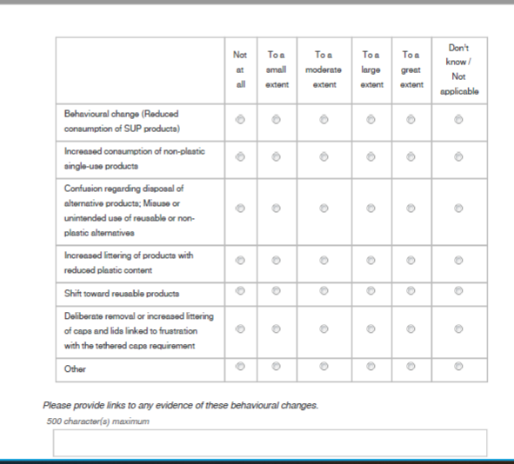

13) Please indicate the extent to which the following behavioural changes have occurred among consumers since the implementation of the SUPD.
68

Slide 73
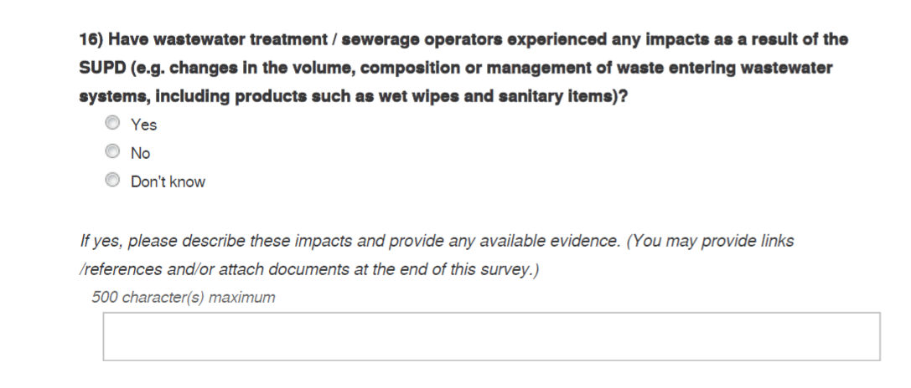
69

Slide 74
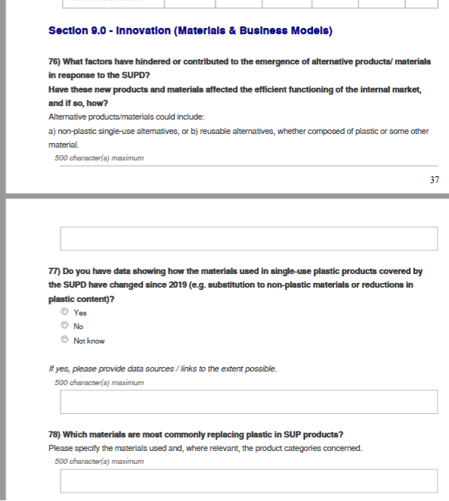


72

